Slide 1
Principles of Service Connection
Columbia VA Regional Office Veterans Benefits Administration
November 2020

Slide 2
Principles of Service Connection
Principles of Service Connection
Service connection connotes many factors but basically it means that the facts, shown by evidence, establish that a particular injury or disease resulting in disability was incurred coincident with service in the Armed Forces, or if preexisting such service, was aggravated therein. This may be accomplished by affirmatively showing inception or aggravation during service or through the application of statutory presumptions.
Current, diagnosed disability
Injury or Disease, in-service or caused by service
Medical nexus between current condition and service
VA has a Duty to Assist with Obtaining Records and a Medical Exam or Opinion.

Slide 3
Principles of Service Connection
Types of Service Connection
Direct
Disability results from an injury or disease incurred in line of duty during active service.
Aggravated
Pre-existing condition was made worse by military service.
Presumptive
Disability presumed to have been caused by service based on location or circumstances of service, or by military service itself.
Secondary
Disability proximately due to, or the result of, a service-connected condition – the s/c condition directly caused the claimed disability.

Slide 4
Principles of Service Connection
Example of Direct Service Connection
Veteran’s STRs show a single complaint of left knee strain in service with a negative separation examination. The Veteran’s claim states, “I hurt my left knee when I fell off of a truck in Vietnam, and it has hurt ever since that time.”
March 2014 x-rays from the Veteran’s orthopedist show traumatic arthritis of the left knee and his private doctor provides a medical opinion stating that the Veteran’s current left knee arthritis is at least as likely as not related to the Veteran’s injury and left knee strain diagnosed in service.
Veteran would be entitled to service connection for traumatic arthritis of the left knee
Event/disease/injury in service (diagnosed with a left knee strain/reported left knee injury)
Current medical diagnosis (03/14 x-rays show arthritis, left knee)
Link between the two (a medical opinion provided by a private doctor)

Slide 5
Principles of Service Connection
Example of Secondary Service Connection
Veteran was diagnosed with degenerative joint disease, left knee on active duty in 1970 and is granted direct service connection in 2000 for the left knee.
Veteran is diagnosed with degenerative joint disease of the right knee in 2006.
A medical opinion is furnished stating that Veteran’s right knee DJD is secondary to his left knee DJD with rationale being the right knee has suffered added stress due to compensating for the disease of the service-connected left knee.
Veteran would be entitled to service connection on a secondary basis for the right knee
Event/disease/injury in service (Veteran is service connected for the left knee)
Current diagnosis (right knee degenerative joint disease)
Link between the two (medical opinion provides the link)

Slide 6
Principles of Service Connection
Example of Aggravation of Pre-Existing Disability to establish Service Connection
Prior to active-duty service, Veteran is diagnosed with hypertension. Physician prescribes diet and exercise to improve blood pressure readings.
While on active duty, Veteran’s blood pressure readings increase, and he is prescribed medication for control of Veteran’s hypertension.
A VA examiner provides a medical opinion indicating that the Veteran’s hypertension was aggravated beyond its natural progression during active-duty service (a rating specialist cannot make this medical determination alone).
The Veteran would be entitled to service connection on an aggravated basis as control of Veteran’s hypertension required only diet and exercise prior to active duty, and while on active duty, medication was added for control.
Event/disease/injury in service (placed on medication for pre-existing hypertension)
Current diagnosis (hypertension, with medication for control)
Link between the two (aggravation of the pre-existing condition during active service)

Slide 7
Principles of Service Connection
Example of Presumptive Service Connection
Veteran served in Da Nang, Vietnam, “boots on ground,” in 1968.
Veteran is diagnosed with prostate cancer in 2013.
Veteran would be entitled to service connection on a presumptive basis for prostate cancer.
Event/disease/injury in service (Veteran served in Vietnam in 1968; VA presumes Veteran was exposed to Agent Orange)
Current diagnosis (prostate cancer)
Link Between the two (§3.309(e) – If a Veteran was exposed to an herbicide agent during active military service, the following diseases shall be service-connected…) VA “presumes” the herbicide exposure caused the prostate cancer

Slide 8
Principles of Service Connection
Types of Claims
Original Claim
First initial claim (there can only be one original)
Initial Claim (new claim)
First claim for one or more benefits
Supplemental Claim
Claim for the same or similar benefit on the same or similar basis was previously denied
Claims for Increase
Claim for increased evaluation of an existing service-connected disability

Slide 9
Principles of Service Connection
Effective March 24, 2015, VA will only recognize compensation, pension, survivors, and related claims if they are submitted on required standard forms.
The standard claim forms for service connection and non-service connected benefits are:
VA Form 21-526EZ Application for Disability Compensation and Related Compensation Benefits
VA Form 21P-527EZ Application for Veterans Pension
For a detailed listing of VA Forms to be used based on the type of benefit sought, visit: www.knowva.ebenefits.gov and search for III.ii.2.B.1.b. Requirements for a Complete Claim Received on or After March 24, 2015.

Slide 10
Principles of Service Connection
After March 24, 2015, any communication received that is not on a standard form will be treated as a Request for Standard Application. A letter will be sent providing instruction on which form is needed to submit a formalized claim.
Intent to File:
VA stopped accepting informal claims on March 24, 2015. Claimants desiring the benefit of filing an informal claim (as expressed in M21-1, Part III, Subpart ii, 2.C.1.b) must now communicate to VA an “intent to file” a claim.
After March 24, 2015, a claimant may submit an Intent to File (ITF) in any of the following ways:
Submitting a completed VA Form 21-0966, Intent to File a Claim for Compensation and/or Pension, or Survivors Pension and/or DIC,
Calling the National Call Center (NCC) at 1-800-827-1000 and notifying a Public Contact Representative (PCR) of his or her intent to file a claim for compensation, pension, or survivors benefits, or by
Initiating an application for benefits via eBenefits/Veterans On-Line Application Direct Connect (VDC), Stakeholder Enterprise Portal (SEP) or Digits-to-Digits (D2D).

Slide 11
Principles of Service Connection
How to file a VA disability claim
Online, By mail, in-person, or with the help of a trained professional
Online:
Visit the va.gov site for a walk-through to determine online filing eligibility: https://www.va.gov/disability/how-to-file-claim/
By mail:
Department of Veterans Affairs Claims Intake Center PO Box 4444 Janesville, WI
53547-4444
With the help of a trained professional
You can work with a trained professional called an accredited representative to get help filing a claim for disability compensation. Get help filing your claim
In person:
Bring your application to a VA Regional Office near you. **Due to COVID-19 restrictions, ensure to verify the RO is open before making the trip.

Slide 12
Principles of Service Connection
Supplemental Claim
Claim for the same or similar benefit, on the same or similar basis, which was previously denied
A Claimant must submit or identify evidence
New-evidence hasn’t been previously considered
Relevant-tends to prove or disprove a matter at issue in a claim
VA Form
20-0995
Within one year of the prior decision or outside the year
Remember:
Same condition but claimed under a different theory – qualifies as a Supplemental Claim

Slide 13
Principles of Service Connection
Before submitting a claim, double check to ensure the information provided on the claim form is accurate and complete.
Provides the name of the claimant; the relationship to the Veteran, if applicable; and sufficient service information for VA to verify the claimed service, if applicable.
Is signed by the claimant or a person legally authorized to sign for the claimant.
Identifies the benefit sought.
Provides a description of any symptom(s) or medical condition(s) on which the benefit is based, to the extent the form prescribed by the Secretary so requires.
Want to read additional information?
Visit www.knowva.ebenefits.gov today!
M21-1, Part III, Subpart ii, Chapter 2, Section B - Claims for Disability Compensation and-or Pension, and Claims for Survivors Benefits

Slide 14
Principles of Service Connection
Resources:
KnowVA is an external-facing Web platform that provides you access to the same information claims processors use to process and make decisions on benefits claims. It contains new features like the ability to conduct key word searches, browse by topic or search by specific question. The information is always updated so you’ll never fall behind on the most up-to-date guidance.
www.VA.gov –VA’s primary website
Introduction videos on VA’s YouTube Channel:
https://www.youtube.com/watch?v=I_hn7Xv6KZI&feature=youtu.be
https://www.youtube.com/watch?v=2KR8K8MQSVs&feature=youtu.be
https://www.youtube.com/watch?v=uY6OrcwOalw&feature=youtu.be
https://www.knowva.ebenefits.va.gov/
Get answers to common questions about signing in to VA.gov to manage your benefits and services online. Find out how to sign in with your existing My HealtheVet or DS Logon account—or how to use ID.me to create your account.
https://www.va.gov/sign-in-faq/

Slide 15
Principles of Service Connection
Stay up to date with information from the Columbia VA Regional Office by visiting our internet site:
https://www.benefits.va.gov/ROCOLUMBIA/index.asp
Columbia VA Regional Office
6437 Garners Ferry Road Columbia, SC 29209
Public contact is available to meet with you “virtually” or in-person.
Call us at (803) 647-2488, or email VetAsst.VBACMS@va.gov, and provide your:
Name
Contact information and,
Best time of day for contact between 8:00am and 4:00pm
Then, a VA representative will call or email you back within 24 hours to assist!
Hours of operation:
Monday–Friday, 8am–4pm On Wednesdays, Public Contact hours will be from 8:30am - 4pm.
VA's Inquiry Routing & Information System! We are here to answer your questions.
https://iris.custhelp.va.gov/
Questions?

Slide 16
Appeals Management Office
VA Appeals Modernization Act
February 19, 2019
Appeals Management Office

Slide 17
Objectives
Summarize the Appeals Modernization Act (AMA)
Distinguish between the three decision review options
Identify the required application forms for AMA decision review requests
Identify the key regulatory changes resulting from AMA
Explain the opt-in opportunities into the modernized review system from the Statement of the Case (SOC)/Supplemental Statement of the Case (SSOC)
Understand the jurisdiction of AMA claims
Locate resources
Appeals Management Office

Slide 18
References
PL115-55, Veterans Appeals Improvement and Modernization Act of 2017
38 CFR 3.2400, Applicability of modernized review system
38 CFR 3.2500, Review of decisions
38 CFR 3.2501, Supplemental claims
38 CFR 3.2601, Higher-level review
38 CFR 20.202, Notice of Disagreement
Appeals Modernization – VA.gov https://benefits.va.gov/benefits/appeals.asp (new content 2/19/19)
Appeals Management Office

Slide 19
Appeals Modernization Act (AMA)
On August 23, 2017, the Veterans Appeals Improvement and Modernization Act of 2017 was signed into law.
The new law took effect on February 19, 2019
What does this law change?
VBA’s claims and appeals processes
VBA’s decision notification requirements
Who does this law impact?
All VA administrations (VBA, VHA, NCA)
All VBA claimants (Veterans, survivors, and other beneficiaries)
All VBA Business Lines (Compensation Service, Pension and Fiduciary Service, Loan Guaranty Service, Vocational Rehabilitation and Employment Service, Insurance Service, and Education Service)
All VBA claims and appeals personnel
Appeals Management Office

Slide 20
Appeals Modernization Act (AMA)
AMA features a three option framework for claimants to choose from when dissatisfied with VA’s decision on their claim:
Additional changes found in the new law include:
Improved notification of all VA decisions (8-point requirement)
Effective date protections for continuously pursued claims
Findings favorable to a claimant are binding on VA and Board adjudicators
Elimination of the split jurisdiction between VBA and the Board for appeals processing (no certification process)
Supplemental Claim
Higher-Level Review
Board Appeal
Appeals Management Office

Slide 21
Three Review Options
VBA |  | BVA
Supplemental Claim | Higher-Level Review | Board Appeal
Replaces “reconsiderations” and “reopening” claims with “new and material” evidence VA will readjudicate a claim if “new and relevant” evidence is presented or identified with a supplemental claim (open record). VA will assist in gathering new and relevant evidence (duty to assist). Effective date for benefits is always protected when submitted within 1 year of prior decision. Tracked and controlled under EP 040 series Decisionmakers are Veterans Service Representatives (VSRs) and Rating VSRs (RVSRs) | More experienced VA employee takes a second look at the same evidence (closed record and no duty to assist). Option for a one-time telephonic informal conference with the higher-level reviewer to discuss the error in the prior decision De novo review with full difference of opinion authority Duty to assist errors returned to lower-level for correction (quality feedback) Tracked and controlled under EP 030 series Decisionmakers are Decision Review Officers (DROs) and Senior VSRs | Evidence only docket: The appellant may submit evidence within the 90 day window following submission of the NOD. The Board does not have a duty to assist and the record is otherwise closed. Direct docket: The appellant receives direct review by the Board of the evidence that was before VBA in the decision on appeal. The Board has a 365-day timeliness goal for this docket. Quality feedback loop for VBA. Hearing docket: The appellant will be scheduled for a Board hearing. Additionally, the appellant may submit evidence within the 90 day window following the scheduled hearing. The Board does not have a duty to assist and the record is otherwise closed.
Appeals Management Office
20

Slide 22
New Decision Review Process
Veterans Benefits Administration
Board of Veterans’ Appeals
The Claim
Establishes Effective Date
VBA Decision
(Improved Notice)
Higher-Level Review
Same Evidence
125-Day Avg. Goal
Supplemental Claim
New Evidence
125-Day Avg. Goal
Appeal (NOD)
3 Options
365-Day Avg. Goal
120 Days
Except for appeals to the Court and Supplemental Claims, all filing deadlines are one year.
Court of Appeals for Veterans Claims
21
Appeals Management Office

Slide 23
“Opt-in” Opportunities for Legacy Appeals
An opportunity for some claimants with a pending legacy appeal to “opt-in” to the new modernized review system at the Opt-in from a Statement of Case/Supplemental Statement of Case.
Opt-in from a SOC/SSOC
Available after the effective date of February 19, 2019
Must be filed within 60 days of receipt of SOC or 30 days for the SSOC, or within the one year appeal period (if any time is still remaining)
22
Appeals Management Office

Slide 24
VBA Workload Distribution
RO VSCs
New Process & RAMP Supplemental Claims
DROC St. Pete
DROC Seattle
New Process HLR
New Process Full Grants
New Process Remands
DROC D.C.
RO Appeals Teams
Legacy Appeals & Full Grants
Receipts
Legacy Remands
New Process HLR Returns
VBA will distribute AMA claims and legacy appeals to ROs for processing based on policy guidance outlined in VBA Letter 20-18-05.
VBA established new Decision Review Operations Centers (DROCs) in FY2018 to process AMA Higher-Level Reviews (HLRs) and Board decisions.
23
Appeals Management Office

Slide 25
AMA Summary
Understandable process
Multiple options for the claimant instead of one
Improved notice to decide which option might be best
Early resolution of disagreements
Each lane with a clearly defined start/end point
Higher-Level Review and Board Appeal options provide quality feedback to VBA
Jurisdiction transparency for better workload/resource projections
VBA as claims agency, Board as appeals agency
Appeals Management Office

Slide 26
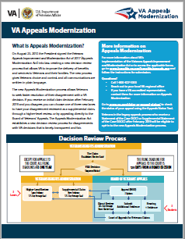
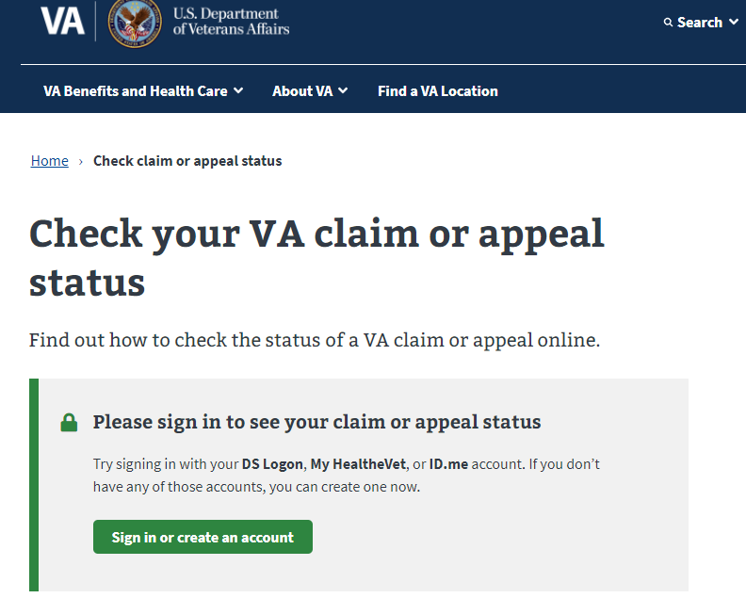
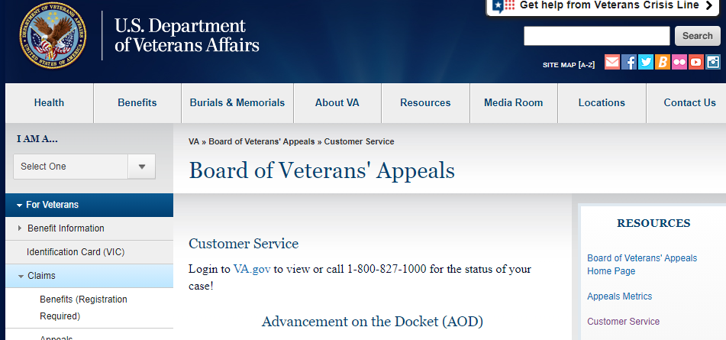
Resources & Materials
The following resources can be found on the VA.gov website at https://benefits.va.gov/benefits/appeals.asp
Appeals Modernization Video
Appeals Modernization Fact Sheet
Appeals Modernization Brochure
Appeals Modernization Infographic
Appeals Modernization Poster
Appeals Status Tracker:
Log into va.gov to track your claim or appeal status!
https://www.va.gov/claim-or-appeal-status/
BVA Customer Service:
https://www.bva.va.gov/CustomerService.asp
Claimants can find information on filing requirements
and the forms to apply at https://www.va.gov/decision-reviews
Appeals Management Office

Slide 27
BVA Contact and Questions
BVA Board Status Line:
Phone: 1-800-923-8387
Fax: 1-202-495-6803
Email a question: https://iris.custhelp.va.gov/app/ask/session
Log into VA.gov
BVA Customer Service:
https://www.bva.va.gov/CustomerService.asp
Questions?
Appeals Management Office

