Slide 1
Processing Loans following a
Natural Disaster Myron Head, ALGO Houston Kathy Bernheim, ALGO St. Petersburg

Slide 2
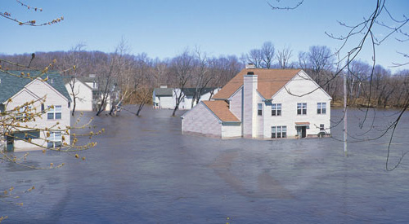
Processing Loans Following a Natural Disaster
Providing the highest level of service by processing loans efficiently following: -Tornados -Wildfires -Hurricanes -Landslides -Earthquakes -Floods -Volcanic eruptions -Snowstorms -Tsunamis -Other Natural Disasters
Ensuring that the property is not damaged or has been restored to its pre-disaster condition or better

Slide 3
Processing Loans Following a Natural Disaster
Guidance for processing loans:
VA Guidance on Natural Disasters is readily available on VA’s website, https://www.benefits.va.gov/homeloans/documents/docs/va_policy_regarding_natural_disasters.pdf
Guidance is applicable to all natural disasters
No need to wait for specific guidance to be published following a disaster

Slide 4
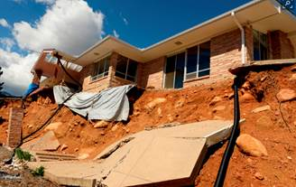
Processing Loans Following a Natural Disaster
Disaster Declarations:
Available at www.fema.gov/disasters
List of Counties
Declaration dates

Slide 5
Processing Loans Following a Natural Disaster
Loans fall into 3 categories:
Loan closed prior to disaster -Eligible for guaranty as usual -Veteran may contact insurance company if property sustained damage
Appraisal not yet completed -Request appraisal as usual -Appraiser will note any apparent needed repairs and consider any effect of the disaster on market value
Appraisal completed, but loan not closed -Additional documentation required (next slide)

Slide 6
Processing Loans Following a Natural Disaster
Documentation required when appraisal completed, but loan not closed, prior to disaster:
Lender Certification that property has been inspected to ensure that it was not damaged or has been restored to pre-disaster condition or better
Veteran Certification that he/she has inspected the property and found the condition to be acceptable. The Veteran acknowledges that he/she will not be charged for any disaster-related expenses and wishes to close the loan.
VA Loan Summary Sheet (VA Form 26-0286) with a notation “Lender and Veteran Disaster Certifications Enclosed”. If the local authority requires additional inspections, they must be provided at no cost to the Veteran.
If there is an indication of a decline in value, the lender must have the appraiser update the original value estimate. If the appraiser’s update confirms a decline in value, the loan amount must be reduced accordingly.
Employment/Income Certification confirming that the Veteran’s employment and income have not changed. Any changes must be evaluated prior to closing.

Slide 7
Processing Loans Following a Natural Disaster
Appraisal related questions:
Lenders may contact the fee appraiser for repair certifications
Appraisers may be unavailable due to the disaster
If unable to reach the appraiser, lenders should contact the RLC to have another appraiser assigned
Fees for appraisal-related inspections or any other disaster-related expenses may not be charged to the Veteran

Slide 8
Processing Loans Following a Natural Disaster
General guidance for natural disasters will also apply to disasters that may involve one or a small number of homes, for example: -House fire -Tree falling on a house -House struck by a car
While there will not be a disaster declaration, the same general processing steps should be followed to ensure the property is repaired and that every opportunity to avoid foreclosure is provided to Veterans with closed loans.

Slide 9
Processing Loans Following a Natural Disaster
Related information:
Assistance to Homeowners – Servicers are encouraged to offer forbearance and moratoriums on foreclosures. Veterans should contact their servicer or the RLC for assistance.
Specially Adapted Housing (SAH) – Supplemental grant funds may be available if a home on which a Veteran used an SAH grant is damaged in a natural disaster. Please contact the RLC for assistance.

Slide 10
Processing Loans Following a Natural Disaster
Questions?

Slide 11
Processing Loans Following a Natural Disaster

