Slide 1
The Lender Scorecard
Presented by:
Greg Nelms, Chief, Loan Policy, Washington DC

Slide 2
Loan Guaranty Mission Statement
Maximize Veterans’ and Servicemembers’ opportunity to obtain, retain, and adapt homes by providing a viable and fiscally responsible benefit program in recognition of their service to the Nation.
Notes:
Or Lender verifies income in accordance with VA’s UW requirements.

Slide 3
Purpose
“Measurement is the first step that leads to control and eventually to improvement. If you can’t measure something, you can’t understand it. If you can’t understand it, you can’t control it. If you can’t control it, you can’t improve it.”
H. James Harrington
Notes:
Or Lender verifies income in accordance with VA’s UW requirements.

Slide 4
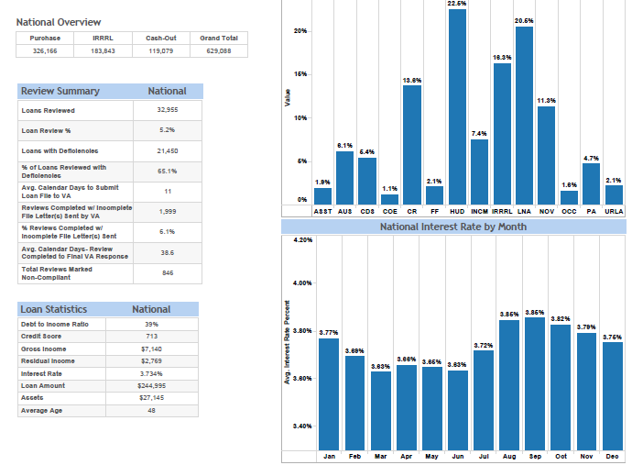
CY15 National Scorecard

Slide 5
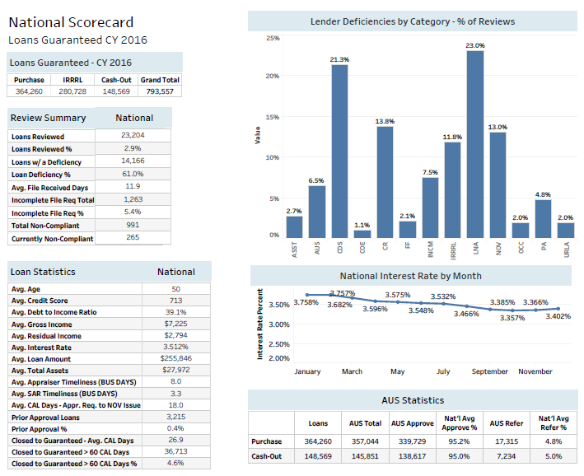
CY16 National Scorecard

Slide 6
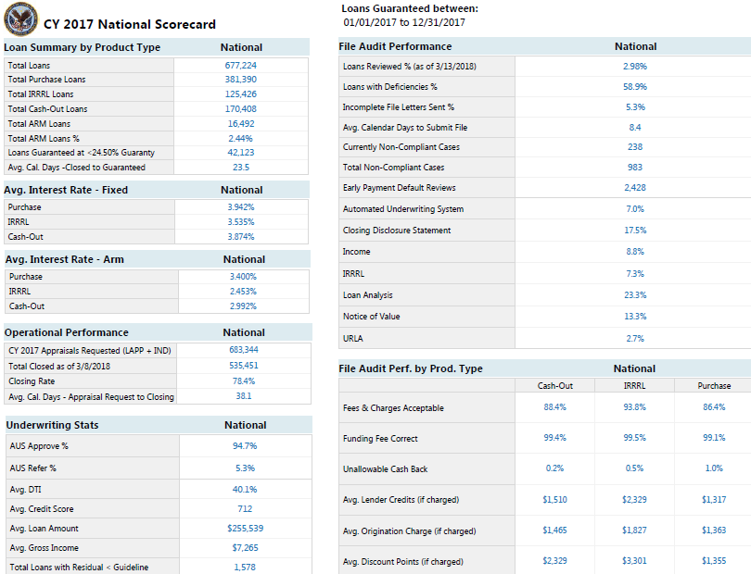
CY17 National Scorecard

Slide 7
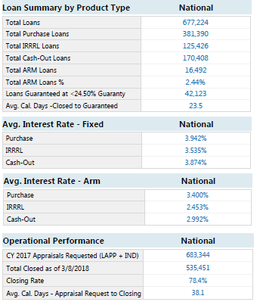
Purpose
Transparency
How is VA doing?
How many?
Loans and types of loans
Rate comparisons
How long & how well?
Milestones
Metrics
Notes:
Or Lender verifies income in accordance with VA’s UW requirements.

Slide 8
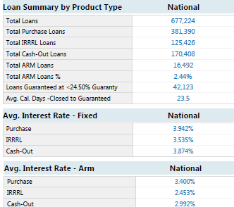
Purpose
Awareness
How do I compare to
the VA National average?
Production
What is my VA loan product mix?
Purchase vs. Cash-Out vs. IRRRL
Fixed vs. ARM
Competitiveness
Rate comparison
Fee comparison
Notes:
Or Lender verifies income in accordance with VA’s UW requirements.

Slide 9
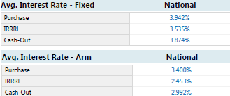
Purpose
Performance
How does VA view lender performance?
Veteran experience
Rate
Fees / lender credits
Closing rate
Time to closing
How do you perform with VA / potential impact on VA
resources?
Low guaranty percentage
Guaranty timeliness
Closing rate
Accuracy
Notes:
Or Lender verifies income in accordance with VA’s UW requirements.

Slide 10
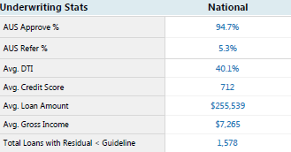
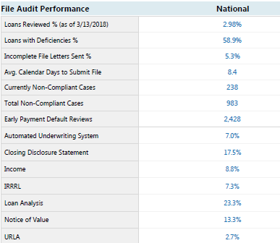
Purpose
Performance (continued)
Lender loan characteristics at guaranty
Underwriting
AUS percentage
DTI
Credit score
Loan amount
Loans that do not meet residual guideline
Loan reviews (RLC file audits)
Percentage of your files VA reviewed
Percentage of your files with a deficiency
Responsiveness to audit requests
Non-compliance to file requests
or deficiencies
Early payment default reviews
File review deficiency types
Notes:
Or Lender verifies income in accordance with VA’s UW requirements.

Slide 11
Definitions

Slide 12
Definitions (Cont.)
Loan Summary by Product

Slide 13
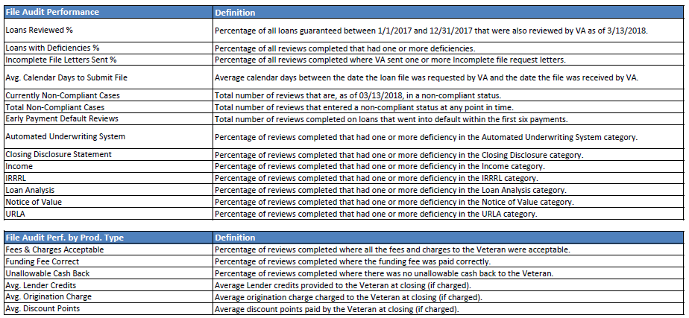
Definitions (Cont.)
Loan Summary by Product

Slide 14
Loan Guaranty Mission Statement
Maximize Veterans’ and Servicemembers’ opportunity to obtain, retain, and adapt homes by providing a viable and fiscally responsible benefit program in recognition of their service to the Nation.
Notes:
Or Lender verifies income in accordance with VA’s UW requirements.

