Slide 1
The Notice of Value (NOV)
Presented by:
Myron Head, Assistant Loan Guaranty Officer, Houston RLC
Phyllis Chilton, Valuation Officer, Phoenix RLC

Slide 2
Presented by:
Myron Head
Assistant Loan Guaranty Officer
Houston RLC
Phyllis Chilton
Valuation Officer
Phoenix RLC

Slide 3
Objectives
Discuss the Notice of Value (NOV)
Conditions
Minimum Property Requirements (MPR)
Please hold case specific, unusual, and complex situations until the end (we will address them individually)

Slide 4
Notice of Value (NOV)
NOV establishes the estimated reasonable value of the property
NOV includes a list of conditions and requirements that must be satisfied for the property to be eligible for VA loan guaranty
Every VA appraisal must be reviewed by either the
Lender’s SAR or
VA Staff Appraiser
SAR has 5-business days to issue
VA Staff has 3-business days to issue
Liquidation NOV – 7-business days

Slide 5
Energy Efficient Mortgage (EEM)
NOV Condition #1
Existing construction
Used in conjunction with purchase or refi
Types of improvements
Solar or conventional heating/cooling systems
Water heaters/including solar
Insulation
Weather-stripping and caulking
Furnace efficiency modifications
Clock thermostats
Heat pumps
Storm window and/or doors
Vapor barriers
Funds for EEM improvements are considered part of the total loan
Up to $3,000 – based on documented costs
Up to $6,000 – increase in P&I offset by likely reduction in utility costs
Over $6,000 – must be supported by value

Slide 6
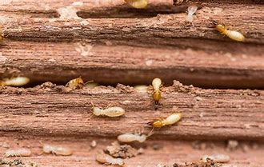
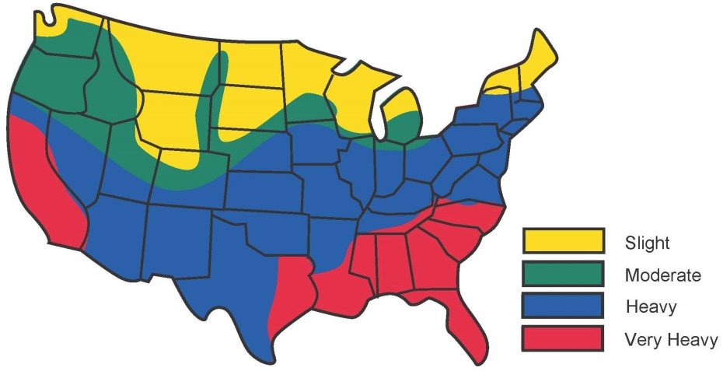
Wood Destroying Organism Inspection
NOV Condition #2
All properties located in an area where the probability of termite infestation is:
“very heavy”
“moderate to heavy”
require a termite inspection
The NOV will be marked
item 2a for Existing Construction
Item 2b for Proposed or Under Construction
All required treatment and damage repair must be completed prior to loan guaranty

Slide 7
Lien-Supported Assessment
NOV Condition #3
Identifies properties located within a development with mandatory membership in a homeowner’s association (HOA)
3a – Enter the estimated HOA/PUD fee selecting the period (year or month)
3b – Enter all special assessments
From the “issue NOV screen”, the special assessment fee must be entered in the “other description” box in order to populate on the NOV

Slide 8
Condominium Requirements
NOV Condition #4
The lender is responsible for ensuring that the condominium is acceptable to VA and that any condominium-related special conditions or requirements have been met

Slide 9
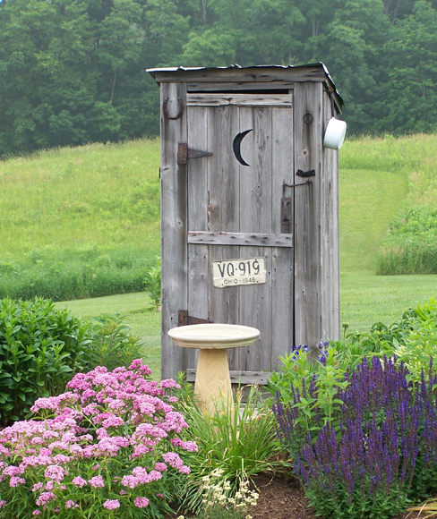
Water / Sewage System Acceptability
NOV Condition #5
Water quality must meet the requirements of health authority having jurisdiction
If no local authority, levels established by EPA apply
Individual sewage disposal system must adequately dispose of all domestic wastes in a manner which will not create a nuisance, or in any way endanger the public health

Slide 10
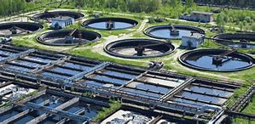
Connection to Public Water / Sewer
NOV Condition #6
Connection to public or community water / sewage disposal system is required whenever feasible.

Slide 11
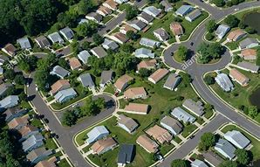
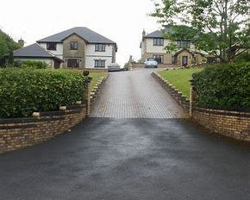
Private Road / Common-use Driveway
NOV Condition #7
Each property must be provided with a safe and adequate pedestrian or vehicular access from a public or private street
Private streets must be
protected by a permanent easement, and
maintained by a homeowners association or joint maintenance agreement.
All streets must have an all-weather surface
HOA/PUD
Rural Road
Shared Private Drive
Contact the RLC of jurisdiction for specific geographical requirements

Slide 12
Flood Insurance
NOV Condition #8
Appraiser indicates flood zone in report
SAR marks NOV
Flood zones requiring insurance
A
V
Proof of Flood Insurance required for loan guaranty
Cannot be waived

Slide 13
“Airport” Acknowledgement
NOV Condition #9
The appraisal report must identify any airport noise zone or safety-related zone in which the property is located
An airport Noise Zone 3, if proposed or under construction is not eligible for guaranty
Refer to The Lender’s Handbook chapter 11.12.j for additional information

Slide 14
Repairs
NOV Condition #10
Only VA Minimum Property Requirements (MPR) are listed as repairs on the NOV
Repairs can be certified by the Lender or appraiser
Lenders should use their own letterhead when certifying repairs have been completed
A certification regarding the condition or adequacy of the roof, electrical/plumbing/heating systems, etc. should NOT be required unless there is an indication of a problem

Slide 15
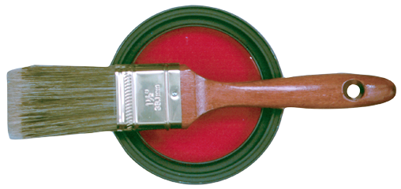
Lead-Based Paint
NOV Condition #10
Properties built prior to 1978 may contain lead-based paint
Lead-based paint constitutes an immediate hazard that must be corrected prior to loan guaranty
Any defective paint condition identified must receive adequate treatment
Refer to The Lender’s Handbook, chapter 12.06 for additional information

Slide 16
Local Housing / Planning Authority Code Requirements
NOV Condition #11
This condition, while still appears on the NOV, does not appear on the “save/issue NOV” screen
VA expects all local conditions to be met

Slide 17
“Not Inspected” Acknowledgement
NOV Condition #12
VA no longer inspects new property during construction; therefore:
If the builder provides a 1-Year Warranty - VA assistance with construction complaints will be limited to defects in equipment, material, and workmanship reported during the one-year builder’s warranty period
If the builder did not provide a 1-Year Warranty – VA will not intercede on the Veteran’s behalf in the processing of any construction complaints
Some states require a 1-Year Warranty - check with RLC of jurisdiction

Slide 18
Ten-Year Insured Protection Plan
NOV Condition #13
Evidence of enrollment of the new property in a 10-year insured protection plan acceptable to the Department of Housing and Urban (HUD) is required.

Slide 19
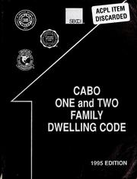
Energy Efficient Construction
NOV Condition #14
For new construction only
Builder’s certification that the new dwelling was constructed to meet the energy conservation standards of the of the Council of American Building Officials (CABO) 1992 Model Energy Code (MEC)

Slide 20
Lead/Water Distribution System
NOV Condition #15
For new construction only
Builder’s certification that the solders and flux used in construction did not contain more that 0.2 percent lead and that he pipes and pipe fittings used did not contain more than 8.0 percent lead.

Slide 21
Offsite Improvements
NOV Condition #16
For new construction only
Evidence that the streets, sidewalks, drains, water, sewer, etc. have been completed and accepted for maintenance for the local authority

Slide 22
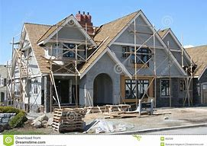
Proposed Construction
NOV Condition #17
Construction exhibits are required for properties appraised as “proposed or under construction”; construction exhibits must include:
Description of Materials (VA Form 26-1852)
Plot plan including location of well/septic system
All exterior building elevations
Foundation or basement plan
Plan of all floors
Sectional wall details
Certification signed and dated by a technically qualified and properly identified individual
Refer to The Lender’s Handbook chapter 10.10 for additional information
Briefly describe information such as model name, bedroom & bathroom count, GLA, etc. in the “proposed construction” box on the “save/issue NOV” screen

Slide 23
Construction Inspections
NOV Condition #18
Check the appropriate box on the “save/issue NOV” screen
Local Authority to perform construction inspections
Local authority does not perform construction inspections

Slide 24
Construction Warranty
NOV Condition #19
Check this box on the “save/issue NOV” screen if builder is providing a One Year Construction Warranty

Slide 25
Other Conditions / Requirements
NOV Condition #20
Check this item and use this space to list any other conditions or requirements necessary to satisfy fee appraiser or local VA office concerns to meet all VA requirements
Do NOT use this space to list lender requirements above and beyond VA requirements

Slide 26
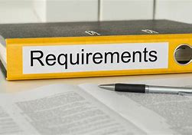
Local Requirements
Local requirements very from state to state
Current local requirements can be found by visiting our website:
http://www.benefits.va.gov/homeloans/appraiser_cv_local_req.asp
Where “no local requirements” are listed, all general VA requirements must be met
Example: A termite inspection is required unless the local requirement states it is not
1. Each State is listed alphabetically, with the VA RRLC of jurisdiction.
2. A VA RLC's local requirements pertain only to properties within the particular state in that RLC's jurisdiction. The primary source of information about VA nationwide requirements is the VA Lender's Handbook local requirements supplement those in the Handbook.
3. Unless otherwise noted, wood-destroying insect information is required per Section 13.06 of the Lender's Handbook. Regardless of the location of the property, an inspection is always required if the appraisal report indicates evidence of wood-destroying insect damage or an active insect infestation.
4. VA offices may instruct fee appraisers to list, when applicable, other local requirements as conditions on appraisal reports. Contact the fee appraiser or VA office if there is a question about an appraisal report condition

Slide 27
NOV Enhancement
Cursory Review – SAR must indicate type of review on the “save/issue NOV” screen
Yes
No
A cursory review is not accepted if:
The valuation risk score is below 300 or above 700
The integrity risk score is above 700
LSAM reveals high alerts
Each of the above must be addressed in SAR notes prior to issuing the NOV

Slide 28
NOV Enhancement
Tidewater
Yes
No
If the appraiser initiated Tidewater, the box must be checked “yes” on the “save/issue NOV” screen

Slide 29
Common Questions
Where do I list Lender requirements (overlays) on the NOV?
Local code requires it when title is transferred, why can’t I put it on the NOV?
What if the NOV exceeds the appraised value?

Slide 30
Conclusion
Summary
Complete and accurate documentation
Timeliness
Proper NOV conditions based on property type and appraisal

