Slide 1
VA Loan Guaranty Service
April 23, 2019
Policy Updates:
Policy in 2019 and 2020
R. Colin Deaso, Chief, Loan Policy
Notes:
Thank you, Molly – and welcome everyone – I’m truly grateful for the opportunity to talk to you today about an exceptionally valuable benefit – the VA-guaranteed Home Loan benefit.
I think it’s always helpful for the audience to have some background on the presenter, so I’d like to briefly introduce myself.
I retired with just over 21 years from the Air Force – I spent half that time enlisted and half as a commissioned officer. Following retirement, I went to work with the Small Business Administration – on their Disaster side, and was deployed to NY following 9/11 to process loans for businesses affected by the disaster. I then obtained my Certified Financial Planner – or CFP – designation and worked in the financial planning industry for a few years before taking a position with VA at our Houston Regional Loan Center. For the past 8 years, I’ve worked our Central Office in Washington, DC – first on the Policy staff and now in my current role as Lender Liaison.

Slide 2
Policy Update Agenda
10:15 - 10:30 - Policy in 2019 and 2020
10:30 – 10:45 – Cash Out : WebLGY
Jennifer Spencer, Loan Specialist
Jeff Bolla, Loan Specialist
10:45 – 12:00 – Cash Out : FAQ
Amy Berumen, Loan Production Officer, Pheonix
Kent Koehler, Loan Production Officer, St. Paul

Slide 3
Policy Updates
Circular | Date | Changes
Policy Guidance for VA Interest Rate Reduction Refinance Loans (IRRRL) | 2/1/18 | Change 1 – 4/5/18
Loans for Alteration and Repair (26-18-6) | 4/5/18
Construction/Permanent Home Loans | 4/6/18
Policy Guidance Update: VA Refinance Loans and the Economic Growth, Regulatory Relief and Consumer Protection Act | 5/25/18
Lender's Certification Requirement for VA Guaranteed Loans | 5/31/18
2019 Department of Veterans Affairs County Loan Limits (26-18-27) | 12/12/18
Revisions to VA-Guaranteed Cash-Out Refinancing Home Loans (RIN 2900-AQ42) (26-18-30) | 12/19/18 | Change 1 – 12/21/18
Special Relief Following the Federal Government Shutdown (26-19-2) | 1/8/19
VA-Guaranteed Cash-Out Refinancing Home Loans (AQ42) (29-19-5) | 2/14/19 | Change 1 – 2/14/19
Handling Unreimbursed Business Expenses and Commission Income (26-19-9) | 3/15/19
?

Slide 4
Policy Updates (cont.)
More Handbook Updates = Less Circulars
Plain English & FAQs
Work in Progress
Updates to Chapter 1, 2, 4, 5, 7, 9
Live Manual transition
90-Day Implementation Periods
Chapter | Effective Date
1 | February 1, 2019
2 | June 26, 2019
3 | Publication Imminent
4 | May 23, 2019
5 | June 30, 2019
6 | In process
7 | June 9, 2019
8 | In process
9 | Publication Imminent

Slide 5
What to expect in 2019/2020: Policy Focus
Rule Making
Cash Out : Final Rule
IRRRL Rule Making
Enforcement Regulation
Handbook/Circulars
Chapter 6 and 8
Revisions/clarifications
90 day implementation window & refinements
Possible Congressional Mandates
Blue Water Navy
Increased Funding Fees
25% Guaranty, across the board
Technology Fee
Goals for Policy Development & Deployment
Simple
Aligned
Communicated
System-based

Slide 6
What to expect in 2019/2020: Tech Focus
VALERI-R
UCD/ULAD Implementation
Improved “lights out“ COE automation
Assumption Workflow
Release Communications

Slide 7
What to expect in 2019/2020: Ops Focus
Communications
Quarterly Push Calls
Handbook Updates
Analytics
Improved oversight/audits targeting
Different types of conversations
Training
Communications
Training
Policy

Slide 8
What to expect in 2019/2020: Ops Focus
Type of Waste | Explanation | Symptoms | Solutions
Defect | Doesn’t meet expectation | Customer dissatisfaction Decreased volume Decreased productivity Policy conflicts System defects Inconsistency Substandard processes/procedures Audit deficiencies | Planning Communication ***Process***
Overproduction | Doing more than you need to
Transportation | Shipping stuff to different locations
Waiting | Didn’t happen when it should have
Inventory | Keeping stuff on hand unnecessarily
Motion | Excess movement
Processing | Doing more that you need to
Intelligence | Not including the input of critical stakeholders

Slide 9
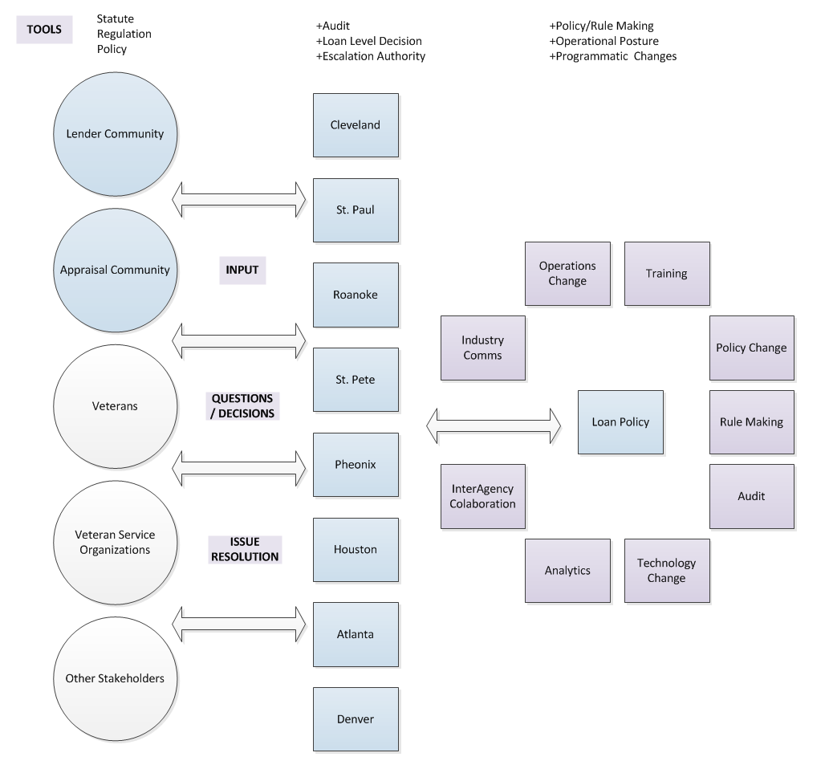
What to expect in 2019/2020: Ops Focus
Broad authority for Lenders
Lenders have access to the same source material (law, regulation, policy) as VA employees
VA Loan Specialists do not interpret policy
RLC management has certain delegated decisioning and escalation authority

Slide 10
QUESTIONS & ANSWERS

