Slide 1
2019 Economic and Housing Outlook
Frank Nothaft
CoreLogic Chief Economist
April 25, 2019

Slide 2
2019 Economic and Housing Outlook
Economic growth continues, recession risk rises over time
2019 mortgage origination volume: similar to last year, but more purchase & less refi
No national price bubble, but overvaluation risk in select areas
Home equity gains, lower homeowner mobility add to remodeling spending
Home mortgages perform well, consumer credit not so good

Slide 3
Economy Forecast to Grow 2.1% in 2019…. When Will the Recession Hit?
When will the U.S. enter recession?
Percent of respondents
2.1% economic growth in 2019 (IHS)
Expansion becomes longest in U.S. history in July 2019 (NBER)
26% 1-year recession probability (WSJ)
Most economists expect recession starts 2020 or later (NABE)
TCJA stimulus dissipates
Higher interest rates
Trade war uncertainty
Source: IHS Markit (GDP growth 2018Q4 to 2019Q4), Wall Street Journal Economic Forecasting Survey (April 2019), National Association for Business Economics Economic Policy survey (February 25, 2019), National Bureau of Economic Research
3

Slide 4
Fed Increasingly Focused on Inflation Risk
March 2019 Unemployment 3.8%
Forecast (IHS): 3.6% (2019 average)
Congressional dual mandate:
Maximum employment
Price stability
U.S. Unemployment rate 3.8% (Mar.)
2019 forecast: 50-year low
“Full employment”: 4.2-4.5%
Fed’s “price stability” definition:
2% annual (PCE)
Avg. inflation 1.9% since 2000
Fed funds target now 2.25-2.50%
No more quarter-point hikes expected until 2020
2019
3.6%
January 2019 Inflation 1.4% (YOY)
Forecast (NABE): 2.0% (2019 Q4/Q4)
2019
2.0%
Source: BLS (unemployment rate), BEA (PCE price index), IHS Markit (unemployment forecast), NABE Outlook (PCE forecast)
4

Slide 5
Mortgage Rates Low but Heading Up
Rates today at 4.1%; 2019 annual average forecast 4.4% (0.1% lower than 2018)
Interest Rate on 30-Year Fixed-Rate Mortgages
Source: Freddie Mac Primary Mortgage Market Survey®; forecast is an average of MBA, Fannie Mae, Freddie Mac, NAHB, NAR and IHS Market projections.
5

Slide 6
Dollar Origination Forecast: 2019 Similar to 2018
Single-family Mortgage Originations (Billions of U.S. dollars)
Consensus
2018 to 2019:
Total: +2%
Refi: -3%
Purch: +2%
---Forecast---
Refinance
Purchase
Source: Originations for 2010-2017 are from CoreLogic public records (benchmarked to HMDA through 2017); 2018 to 2020 are an average of the latest projections released by Mortgage Bankers Association, Fannie Mae and Freddie Mac. Originations exclude HELOCs.

Slide 7
“In the Money” To Refinance Grows with Lower Rates
$1 trillion in debt outstanding with rates between 4.75% and 5.0%
Cumulative Share of Active Balance by Interest Rate
or higher
Source: CoreLogic TrueStandings

Slide 8
Refi Share Projected to Fall to 25-Year Low
Refinance Share of Lending (percent, four-quarter moving average)
Forecast:
2019Q4
25%
23%
1992-93
Boom
1998
Boom
2001-04
Boom
2009-13
Boom
Source: Home Mortgage Disclosure Act (1990-2017); CoreLogic (2018); MBA, FNMA and FHLMC projections (2019)
8

Slide 9
Fraud Risk Higher Since 2016
Decline in refinance share has added to risk
More Risk
Less Risk
Source: CoreLogic Mortgage Fraud Index

Slide 10
U.S. HPI Up 58% from Trough to February 2019
February 2019: 6% above pre-Recession peak, but 14% below after inflation adjustment
CoreLogic Home Price Index (January 2000 = 100)
Forecast
U.S.
Source: CoreLogic HPI (April 2, 2019 release), U.S. HPI pre-recession peak occurred April 2006, trough March 2011; CoreLogic HPI Forecast
10

Slide 11
Price Bubble Metrics
One metric may give a false positive; multiple metrics provide a better informed evaluation
Price-to-Income Ratio: CoreLogic Market Conditions Indicator compares actual CoreLogic HPI with income-based ‘fundamental’ price index
Price-to-Rent Ratio: Compare CoreLogic low-tier HPI with CoreLogic Single-Family Rent Index
Monthly P&I-to-Rent Ratio: compare historical relationship for each CBSA

Slide 12
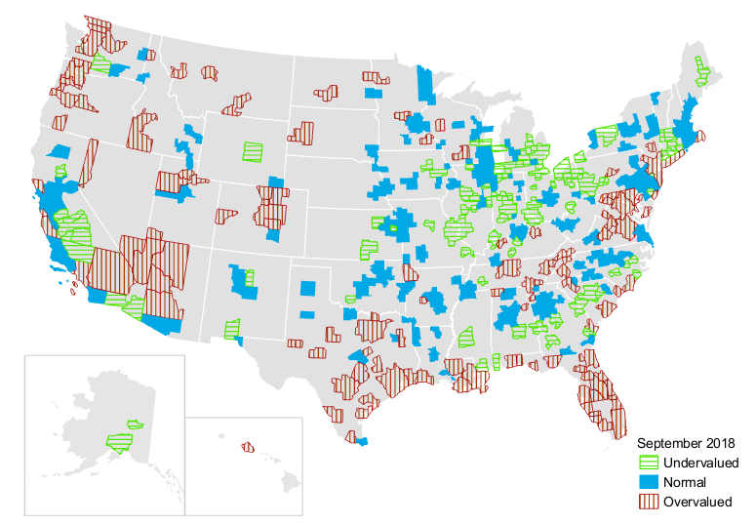
Most Overvalued Metros near Seacoasts or Rocky Mountains
CoreLogic Market Conditions Indicator (MCI)
Source: CoreLogic MCI for 392 metropolitan areas; area is Undervalued/Normal/Overvalued if HPI is below/within/above 10% of fundamental HPI

Slide 13
Bubbles? Market Conditions Indicator, Price-to-Rent, and Payment-to-Rent Ratio, by Metro
Metro Area | Market Conditions Indicator: 2018Q3 | Price-to-Rent: Growth 2001Q1 to 2018Q1 Above or Below 65% | Payment-to-Rent: Growth 2001Q1 to 2018Q1
Los Angeles, CA | Overvalued | Above | 33%
West Palm Beach, FL | Overvalued | Above | 14%
New York, NY | Overvalued | Below | 14%
Seattle, WA | Overvalued | Above | 12%
San Francisco, CA | Normal | Above | 12%
Washington, DC | Overvalued | Above | 8%
Raleigh, NC | Normal | Below | 4%
Tucson, AZ | Normal | Below | -4%
St. Louis, MO-IL | Undervalued | Below | -10%
Houston, TX | Overvalued | Below | -13%
Virginia Beach, VA | Normal | Below | -14%
Trenton, NJ | Normal | Below | -33%
U.S.* | Normal | Below | -15%
* U.S. price-to-rent and payment-to-rent analysis begins 2004Q1
Source: CoreLogic MCI, HPI, median sales price and Single-Family Rent Index, Freddie Mac PMMS for 30-year FRM

Slide 14
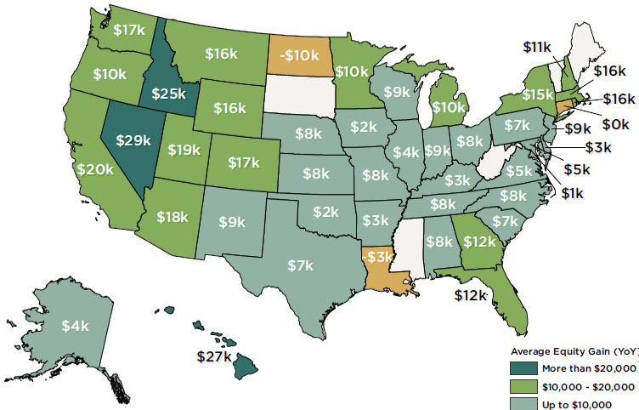
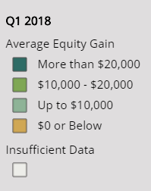
Average Equity Gain per Homeowner
U.S.: $9,700 per home (December 2017 to December 2018)
Q4 2018
Source: CoreLogic Equity Report for 2018Q4

Slide 15
Americans Are Keeping Their Homes Longer
Median up 4 years since 2007
Owner Occupants
Home Sellers
Source: American Housing Survey for the United States, various years (difference between survey year and median year owner-occupant moved into unit), CoreLogic public records for United States (length of time between recorded sales on same home).
15

Slide 16
Remodeling Expenditures Spurred by Existing-Home Sales and Long-Duration Owners with Home Equity
No growth in existing sales forecast for 2019, but material costs up
Homeowner Improvements and Repairs (Billions)
Forecast
5.1% growth in 2019
Source: Harvard University Joint Center for Housing Studies LIRA
16

Slide 17
Cash Out Refinancing Reemerging
In 2012, 10% of refinances were cashout; in 2018Q4 40% were cashout
Cash out refinances as a share of $ refinance originations
December
40%
2001-04
Refi Boom
2009-13
Refi Boom
Source: CoreLogic Public Records (first liens)
17

Slide 18
VA-to-VA Cash-Out Refinance Volume Is Elevated
VA-to-VA Cash-out Refinance (Number per Origination Month)
Source: CoreLogic.

Slide 19
Home Mortgages and Consumer Credit
Subprime loans: largely absent from home mortgage lending but widely available in auto
Home mortgage default has declined to pre-Great Recession level
Auto and student loan default is rising and above pre-Great Recession level
19

Slide 20
VA Delinquencies At 20-Year Low
Source: CoreLogic TrueStandings Servicing (through January 2019). 30+-day delinquency rate includes loans in foreclosure.

Slide 21
VA Serious Delinquency & Foreclosure at 20-Year Low
Serious Delinquency Rate
(90+ days past due)
Foreclosure Rate
Source: CoreLogic TrueStandings Servicing (through January 2019). Foreclosure rate reflects all loans in some stage of the foreclosure process.

Slide 22
Auto Loans Have Lower Credit Scores
Home Mortgage Auto Loan
Borrowers Borrowers
Originations:
(2018)
$1.7 trillion $0.6 trillion
Source: CoreLogic TrueStandings and Federal Reserve Bank of New York Consumer Credit Panel, Equifax
22

Slide 23
Auto and Student Delinquencies High & Rising
90-or-more day delinquency rate by loan type (percent of dollar balance)
Student Loan
Auto
Mortgage
HELOC
Source: CoreLogic TrueStandings (Mortgage serious delinquency rate), Federal Reserve Bank of New York Consumer Credit Panel, Equifax

Slide 24
2019 Economic and Housing Outlook
Economic growth continues, recession risk rises over time
2019 mortgage origination volume: similar to last year, but more purchase & less refi
Overvaluation risk in select areas (N.Y. & L.A. metros, Florida, Pugent Sound)
Home equity gains, lower homeowner mobility add to remodeling spending
Home mortgages perform well, consumer credit not so good

Slide 25
Where to find more information
Look for regular updates to our housing forecast, commentary and data at
http://www.corelogic.com/blog
@CoreLogicInc
@DrFrankNothaft
The views, opinions, forecasts and estimates herein are those of the CoreLogic Office of the Chief Economist, are subject to change without notice and do not necessarily reflect the position of CoreLogic or its management. The Office of the Chief Economist makes every effort to provide accurate and reliable information, however, it does not guarantee accuracy, completeness, timeliness or suitability for any particular purpose.
CORELOGIC and the CoreLogic logo are trademarks of CoreLogic, Inc. and/or its subsidiaries.

