Slide 1
Recent mortgage complaints and a report on mortgages to first-time homebuying servicemembers
VA lenders conference | April 24, 2019

Slide 2
Disclaimer
This presentation is being made by Consumer Financial Protection Bureau representatives on behalf of the Bureau. It does not constitute legal interpretation, guidance or advice of the Bureau. Any opinions or views stated by the presenters are the presenters’ own and may not represent the Bureau’s views.
This document was used in support of a live discussion. As such, it does not necessarily express the entirety of that discussion nor the relative emphasis of topics therein.

Slide 3
Bureau representatives
Tony Camilli, Lt Col, USAFR
Policy and Outreach Specialist
Office of Servicemember Affairs
Patrick Lapid, Ph.D. (USMCR Veteran)
Economist
Office of Research

Slide 4
Overview
Background on the OSA
Home buying education tools and resources
Recent mortgage lending issues reported to the OSA
Report on Mortgages to First-Time Homebuying Servicemembers and Veterans

Slide 5
Background on the OSA

Slide 6

OSA mission #1: Financial Education
Order at:
https://pueblo.gpo.gov/CFPBPubs/CFPBPubs.php
Notes:
Source: Cleared from CEE slides
Talking Points:
- OSA’s first statutory mission is to educate and empower servicemembers, veterans, and their families (and those that serve them) about financial products and services. We do that through a number of ways like this webinar for instance, or blog posts about how topics, or creating educational brochures that provide accurate, thorough and specific advice on hundreds of topics.
- These brochures are available for order consumers and stakeholders to ensure everyone is getting the most objective information that exists, and because we are part of the Federal government there is no cost to order our brochures in mass quantities.
- You can order brochures at the website provided on this slide or by sending us an e-mail request to: military@cfpb.gov

Slide 7
OSA mission #2: Monitor complaints
Notes:
Source: Cleared from 2018 OSA report
Talking Points:
- OSA’s second mission is to monitor complaints received by SMs, vets, and their families. Later I will discuss how our complaint process works at the CFPB and walk you through how to submit a complaint, but for now it’s important to note that OSA personally reviews every single complaint we received from SMs, Vets and families.
- More than 123K total complaints from SMs since the Bureau started and the trend line shows increase.
- #1 complaint for SMs is debt collection (same as general population);
-- But debt collection is much larger category for SM than general population;
-- Why? We don’t have any hard answers, but our hypothesis is that SMs are attractive targets.

Slide 8
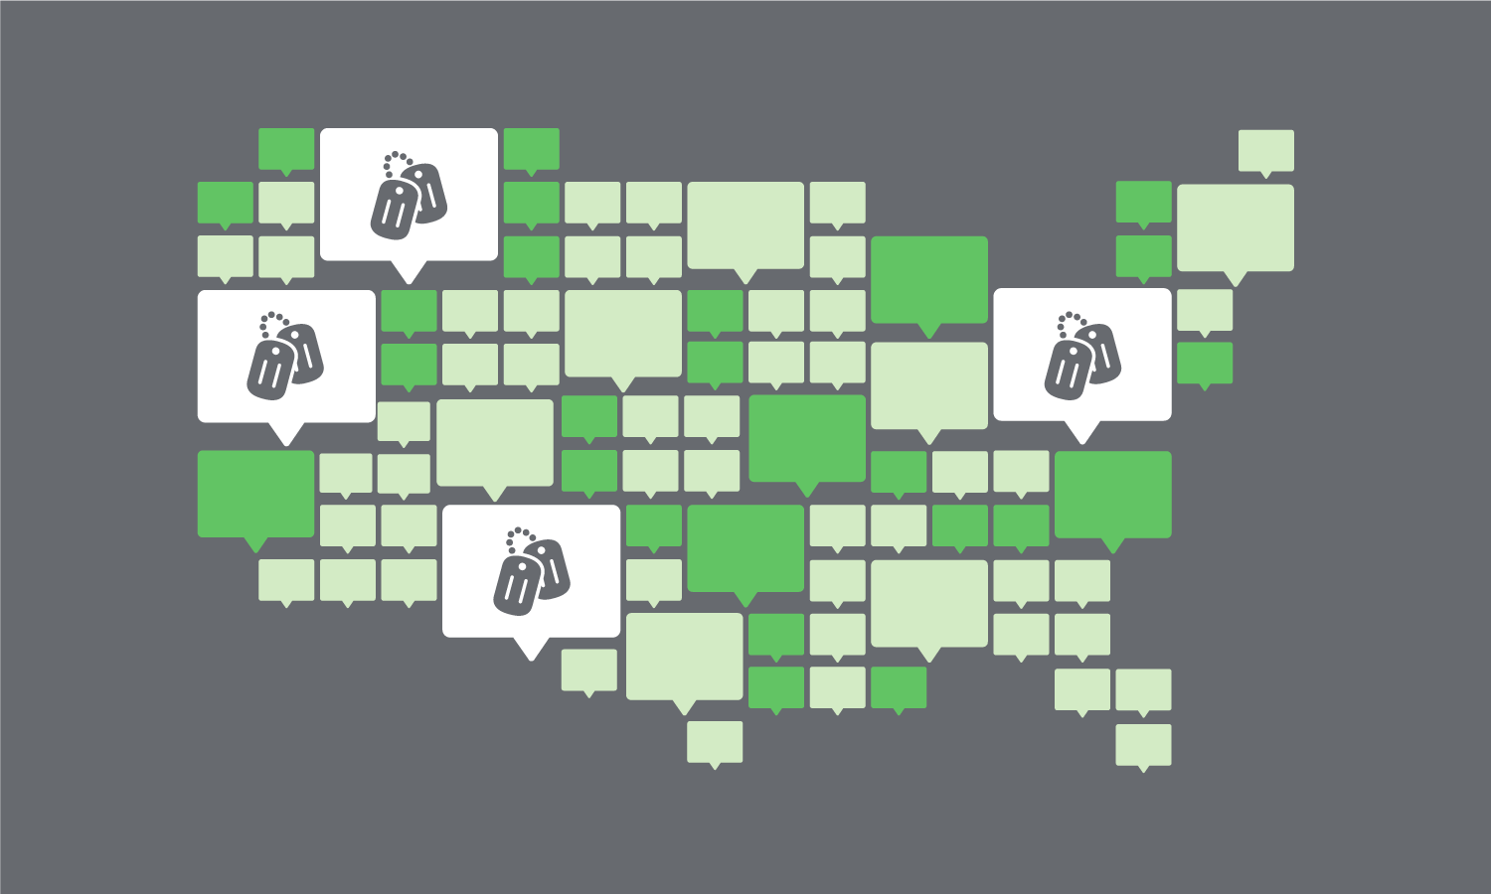
OSA mission #3: Improve consumer protection
Notes:
Source: Cleared from CEE slides
Talking Points:
- OSA Mission #3 under DFA: Coordinating with other Federal, state and local govt agencies on military consumer protection measures.
- Some ways that we’ve done that:
-- student loan servicing & SCRA report;
-- DoEd Policy changes regarding servicemembers;
-- Allotment Abuses-DoD policy change;
-- MLA Final Rule – consulted with DoD
-- Auto-lending blog series with FTC
-- Collaborative blogs with DoD and VA

Slide 9
Home buying education tools and resources

Slide 10
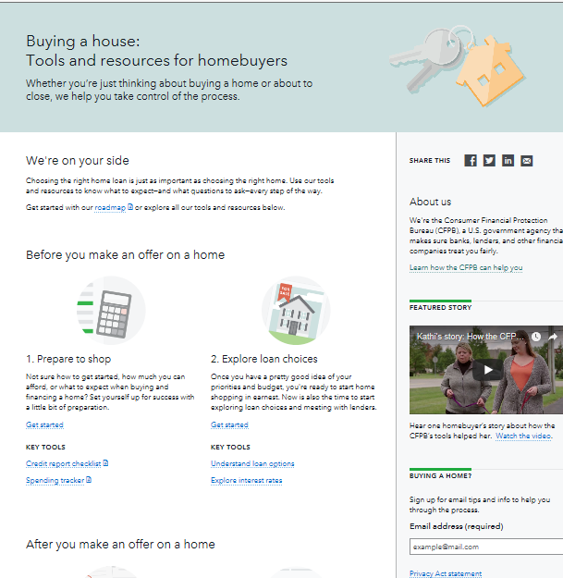

Buying a House
consumerfinance.gov/owning-a-home
Notes:
Source: Cleared from CEE slides
- Our Buying a House tool prepares homebuyers by helping you
-- Prepare to shop for a mortgage and explore loan choices
-- Compare your loan choices and get ready to close on your new home
- Our Loan Estimate Explainer and Closing Disclosure Explainer help you understand your loan estimates and closing disclosure forms so you know what to look for and so you can double check that all the details are correct with your loan.
- Our Home closing checklist is an easy-to-use, downloadable tool to help prepare you for the big day.

Slide 11
Your Home Loan Toolkit
Worksheets, tips, and research starters to help people shop for a home loan
Available in Spanish and English
At consumerfinance.gov: More mortgage help
  Under Consumer Tools, click Mortgages
  Under Practitioner Resources, click Free Brochures
Notes:
Source: Cleared from CEE slides
- To help you navigate the steps you have to take to get a mortgage, take a look at our booklet, “Your Home Loan Toolkit: A Step-By-Step Guide.” This consumer-friendly booklet can help consumers as they think about, apply for, and close on a mortgage. The toolkit helps consumers calculate how much they can afford for a home, gives questions to ask the lender, and features worksheets and checklists to fill out during the process.

Slide 12

Money Topic Resource Portals – Mortgages
consumerfinance.gov/consumer-tools/mortgages/
Notes:
Source: Cleared from CEE slides
- In addition to the other mortgage tools, we have a mortgage resource portal where you can get help on:
-- Understand your monthly mortgage statement
-- Know why your mortgage payment might change
-- Find a HUD-approved housing counselor
-- Learn how to get information or dispute an error about your mortgage
-- Find out how to cancel your private mortgage insurance

Slide 13
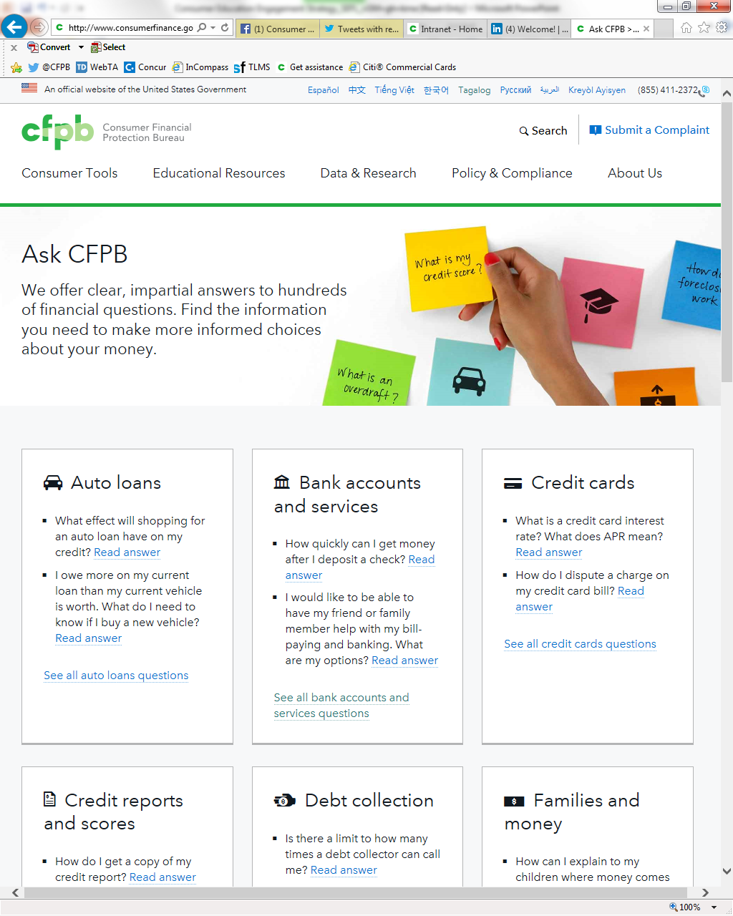
Ask CFPB
consumerfinance.gov/askcfpb
Notes:
Source: Cleared from CEE slides
- This is the most visited consumer tool on cf.gov. Receiving over 20 million visitors since its 2012 launch.
- Approximately 1,100 questions about money topics and financial products and services, including
-- Credit cards
-- Mortgages
-- Student loans
-- Bank accounts
-- Credit reports
-- Debt collection

Slide 14
Recent mortgage lending issues reported to us

Slide 15
Complaints received by product*
*Apr 1, 2017 – Aug 31, 2018
Notes:
Source: Cleared from 2018 OSA report
- Talking Points:
-- for most recent annual report credit or consumer reporting led the way, due in most part by the well-known Equifax breach
-- during our most recent annual report mortgage complaints made up 11% of all SM complaints for the period Apr 17 – Aug 18
-- about 5K of our complaints were for mortgages

Slide 16
Types of mortgage complaints and products from servicemembers, veterans and military families*
*Apr 1, 2017 – Aug 31, 2018
Notes:
Source: Cleared from 2018 OSA report
- Talking Points:
-- from our most recent annual report, the top mortgage issue reported involved “trouble during payment process”
-- our top mortgage type was for conventional loans, which and while 30% of our mortgage complaints involve VA-guaranteed mortgages, this number is probably a good sign – according to our internal research VA-backed mortgages make up a much larger market share for SMs/Vets than 30%

Slide 17
Types of mortgage complaints and products from servicemembers, veterans and military families*
*Apr 1, 2017 – Aug 31, 2018
Notes:
Source: Cleared from 2018 OSA report
- Talking Points:
-- from our most recent annual report, the top mortgage issue reported involved “trouble during payment process”
-- our top mortgage type was for conventional loans, which and while 30% of our mortgage complaints involve VA-guaranteed mortgages, this number is probably a good sign – according to our internal research VA-backed mortgages make up a much larger market share for SMs/Vets than 30%

Slide 18
What we’re hearing …
Complaint #1: “I am at a complete and total loss. I need help. I am trying to serve my country, but it is difficult to concentrate on that when in the back of my head I know my family is in jeopardy of being homeless because of the unresponsive, unethical and illegal practices of _____________.”
Complaint #2: “It was terrifying to live everyday with the possibility of being forced out of your home even you sought assistance and assistance was there but not for me, a veteran.”
Complaint #3: “This has been our primary home since 2008 and were up to date with our mortgage company ________ up to hurricane Irma. We are a military family with girls under the age of 6. … I am filing this complaint because due to the lack of attention to our case this is affecting us and they have denied to reopen my case for the disaster modification.”
Notes:
Source: all complaints are from consumers that provided consent to publish their narratives. We have removed the names of the financial institutions.
- Complaint #1: #190102-3730390
- Complaint #2: #170619-2178750
- Complaint #3: #181024-3572219
Talking Points:
- Read each quote
- Each of these consumers consented to publicly sharing their story on our Consumer Complaint Database.
- We share these quotes with you not to embarrass or shame any lender – our goal is to highlight that servicemembers and veterans often have particular circumstances in their lives that make it harder for them than the average consumer to resolve mortgage issues.

Slide 19
Mortgages to First-Time Homebuying Servicemembers

Slide 20
Report in brief
How have first-time homebuying servicemembers’ (veterans and active duty) home loan choices evolved from 2006 to 2016?
Comparisons across the following areas:
  Loan types (VA, conventional, FHA/USDA)
  Median loan amounts at origination
  Early delinquency rates: 60+ days within one year of origination

Slide 21
Data description and sample selection
Consumer Credit Panel (CCP): 1-in-48 sample of de-identified consumer credit records
Servicemember Civil Relief Act (SCRA) database match
  Performed by consumer reporting agency
Sample for analysis: first-time home buyers, age 42 and younger, who took out a home loan between 2006-2016
  Servicemember status from SCRA
  First-time home buyer: no prior home loan as of 2005 Q1
  Age ≤ 42: SCRA data requires military service after September 1985; older servicemembers not identified in CCP/SCRA match
Notes:
Age ≤ 42: SCRA data requires military service after September 1985
Dec 2017 CCP archive: veterans proportionally represented up to age 54
Keep consistent age range window for 2005—17
First-time home buyer: no home loan tradeline seen in 2005 Q1

Slide 22
Home loan shares to first-time homebuyers
(1) Time period | (2) First-time homebuyer share of all new home loans | (3) Servicemember share of all first-time homebuyers (in column 2) | (4) Active-duty share of all first-time homebuying servicemembers (in column 3)
2006-2007 | 16 | 7.3 | N/A
2008-2011 (housing crisis) | 13 | 7.3 | 37
2012-2016 | 14 | 7.5 | 32
All values expressed as percentage points
Active-duty status only known from 2008 onward
Notes:
Table 1 shows that the servicemember and active-duty shares of first-time homebuyers have stayed relatively constant during the 2006–2016 study period.
The share of all new mortgages in the CCP—that is, both purchases and refinances—that went to first-time homebuyers was 16 percent during 2006 and 2007, and decreased to 13 to 14 percent from 2008 to 2016 (Table 1, column 2).
The servicemember share of all home loans to first-time homebuyers, shown in column 3, varied little across all time periods at just over seven percent.
The servicemember share of first-time homebuyers is slightly higher than the five to six percent servicemember share of consumers in the CCP.
About one-third of these first-time homebuying servicemembers took out their home loan while on active duty.

Slide 23
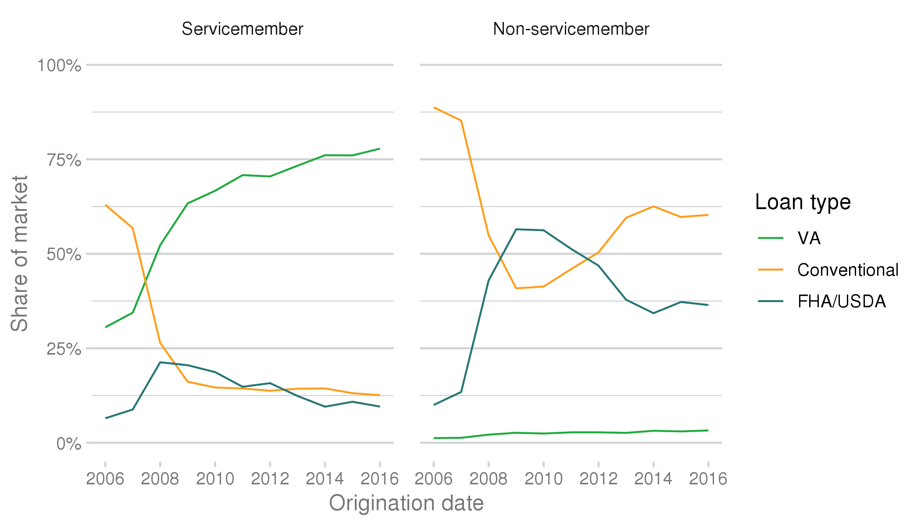
Home loan shares: first-time homebuyers, servicemembers vs. non-servicemembers
Notes:
Figure 1 in report: first-time homebuyers ages 42 and younger;
Servicemembers (left panel):
Sharp drop in share of new conventional mortgage originations after 2007, for servicemembers and non-servicemembers
Increase in VA loan share among servicemembers, from about 30% before 2007 to 63% by 2009, and increasing up to 78% in 2016
60% of servicemembers using conventional loans in 2006-2007, but fell during housing crisis down to 13% of servicemembers in 2016
- Small fraction use FHA/USDA loans; peaked in 2008 at 21% and fell back to 10% by 2016
Non-servicemembers (right panel):
Before 2008, conventional home loans made up almost 90 percent of new home purchases
By 2009, the conventional share of loans to non-servicemembers fell to 41 percent
FHA/USDA loans making up the majority share of first-time non-servicemember mortgages from 2009 to 2011
From 2013 onward, the FHA/USDA share hovered below 40 percent.
A small fraction of non-servicemembers also participated in VA loans, either as a joint buyer with a servicemember co-borrower, or as a surviving spouse of a servicemember.

Slide 24
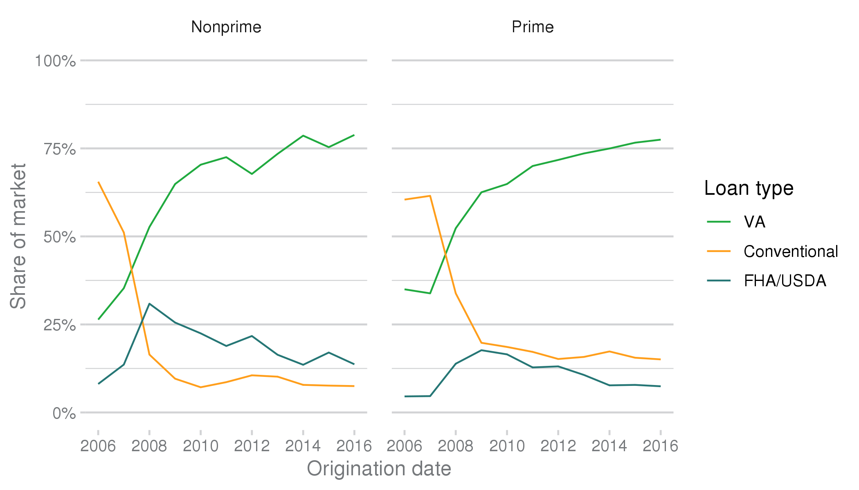
Home loans to servicemembers: by credit category
Notes:
Figure 2: shares for VA home loans rose similarly among first-time homebuying servicemembers with nonprime scores (left panel) and servicemembers with prime scores (right panel)
Somewhat steeper increase in 2007--2009 in VA share for nonprime borrowers
Both series move from under 40 percent before 2008 to almost 80 percent by 2016
Among servicemembers, nonprime borrowers more likely to use FHA/USDA vs conventional loans;
Prime borrowers more likely to use conventional vs. FHA/USDA loans

Slide 25
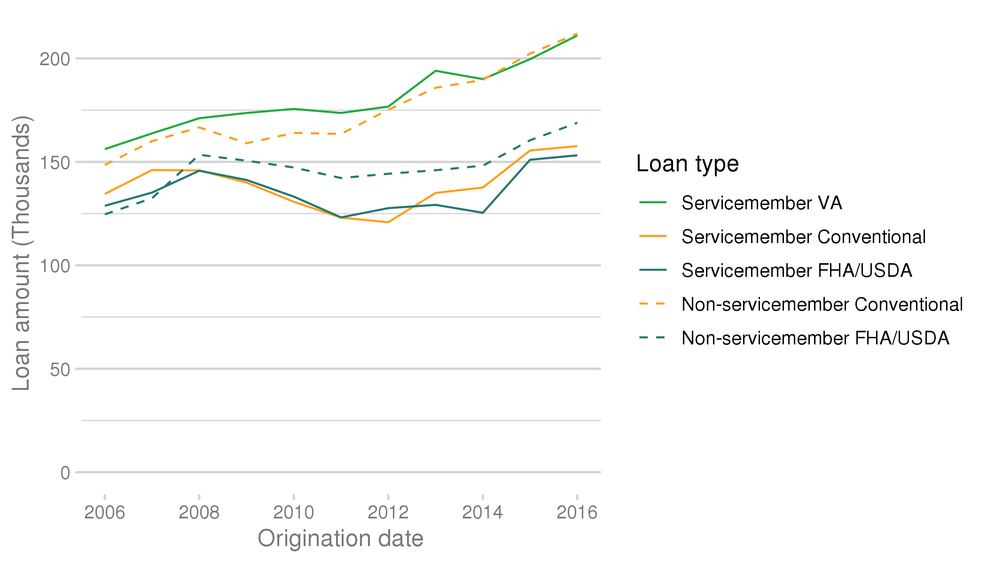
Median loan amounts: by loan type and servicemember status
Notes:
Figure 3: median values of home loans to first-time homebuyers, both servicemembers and non-servicemembers.
Among servicemembers, median VA loan amount was greater than the median value of a conventional or FHA/USDA home loan in the same year
The median VA loan amount increased in nominal dollars from $156,000 in 2006 to $212,000 in 2016, similar to conventional home loan amounts taken out by non-servicemembers.
Median conventional and FHA/USDA loan amounts for servicemembers were generally less than $150,000 from 2005 onward
only after 2014 for both loan types were they greater than $150,000;
Both types lower than the median value of non-servicemember FHA/USDA loans from 2008 onward

Slide 26
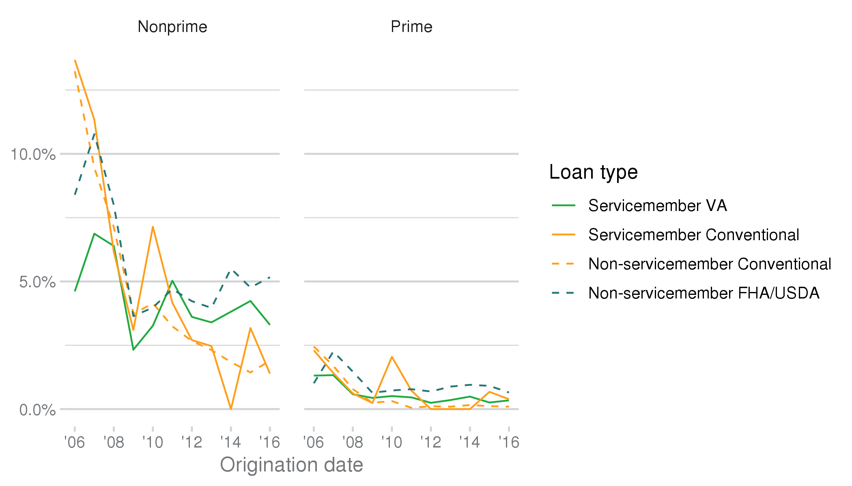
Early delinquency rates: by servicemember status, credit category, and loan type
Notes:
Figure 4: early delinquency rates by loan origination year, as measured by the percent of loans 60 days or more delinquent within one year of origination, on loans taken out by borrowers age 42 or younger for different types of mortgages.
- Comment: may reflect underwriting quality (fraud?) instead of
Excluded due to small sample sizes: VA loans to non-servicemembers; FHA/USDA loans to servicemembers; their performance is similar to other VA and FHA/USDA loans
Nonprime borrowers (left panel):
VA loan delinquency rates for servicemembers peaked in 2007 at approximately seven percent and fell to a little over three percent by 2016.
By contrast, btw 2006 and 2008, delinquency rates among nonprime borrowers were significantly higher for FHA/USDA loans to non-servicemembers as well as for conventional loans to both servicemembers and non-servicemembers.
The delinquency rate of FHA/USDA loans to non-servicemembers with nonprime scores reached a peak of almost 11 percent in 2007, then fell to five percent in 2016.
Conventional loans to nonprime borrowers, for both servicemembers and non-servicemembers, had delinquency rates greater than 13 percent in 2006, but fell under two percent by 2016.
After 2009, conventional loans to all nonprime borrowers generally had lower delinquency rates (under five percent) than both VA loans to nonprime servicemembers and FHA/USDA loans to nonprime non-servicemembers.
Prime borrowers (right panel): considerably lower in general
VA delinquency rate ranged from 0.3 to 1.3 percent,
compared to 0.6 to 2.3 percent for FHA/USDA loans.
Conventional loans’ delinquency rates were higher than the delinquency rate for VA loans before 2008, ranging between 1.4 and 2.4 percent; but generally below the VA loan delinquency rate for loans originated after 2009

Slide 27
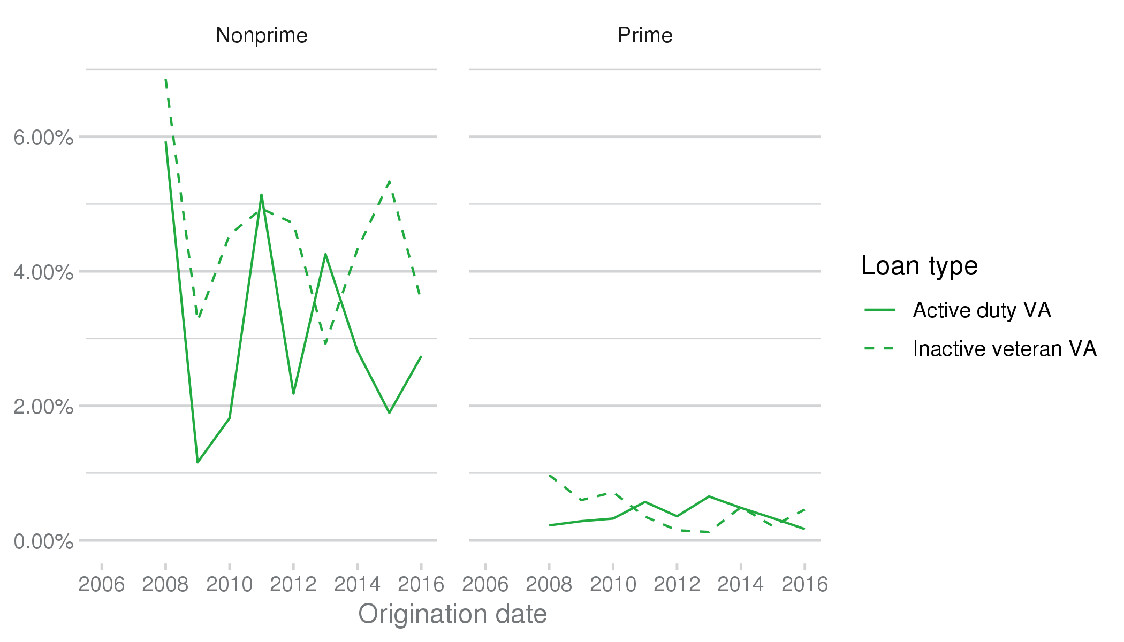
VA early delinquency rates: by active duty status and credit score
Notes:
Figure 5: early delinquency rates, servicemembers who applied for and paid their VA mortgage while on active duty vs veterans
Nonprime active duty generally have lower early delinquency rates
Delinquency rates are declining for both groups: from 5.9 percent in 2008 down to 2.7 percent in 2016 for active-duty borrowers, compared to 6.8 percent in 2008 down to 3.6 percent in 2016 for veteran borrowers.
prime borrowers (right panel),
delinquency rates for all origination years are all below one percent for VA loans, and there is no material difference in VA loan performance for active-duty versus veteran servicemembers.

Slide 28
Summary
VA loans among servicemembers doubled in market share from 2007 to 2009; rose to almost 80% by 2016
  Conventional loan share among servicemembers declined in response
  Similar increase in market share across servicemembers with nonprime and prime credit scores
Early delinquency rates for VA loans for nonprime borrowers:
  Lower rates compared to other loan types up to 2009
  After 2009, lower than FHA/USDA, higher than conv. loans
  Active-duty borrowers have lower delinquency rates compared to veterans

Slide 29



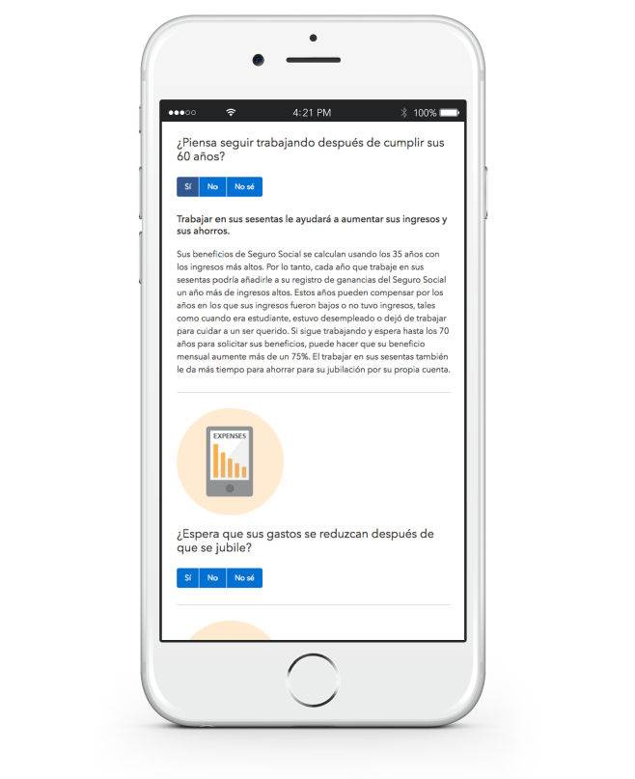

Connect with the CFPB & the Office of Servicemember Affairs
@CFPB
@CFPBmilitary
military@cfpb.gov
E-mail distribution
Notes:
Source: Cleared from CEE slides
Talking Points:
- OSA is the only CFPB office to have its own social media accounts! Please stay connected to us through FB and Twitter to see what’s new in the area of consumer finance for SMs/Vets
- Please add a link to us on your website and/or any intranet pages;
- Send a message to our org inbox to receive the latest info on enforcement actions, trending data, etc;
- We want to hear from active duty, Guard, Reserve, retirees, family members, and veterans – the whole military community;
- Order free Bureau brochures to distribute to your SMs, veterans and families.

