Slide 1
Enrollment Manager Paper-Based SCO Webinar Series for Institutions of Higher Learning and Non-College Degree Programs

Slide 2
Agenda
EM Overview
EM Resources
This webinar is intended to provide an overview of Enrollment Manager (EM), how Paper-Based forms translate to the new EM system, outline EM communication channels, and to provide helpful resources to support your learning.
EM Terminology
Q&A
Accessing EM
EM Key Functionality Demonstrations
EM Communications

Slide 3
EM Overview

Slide 4
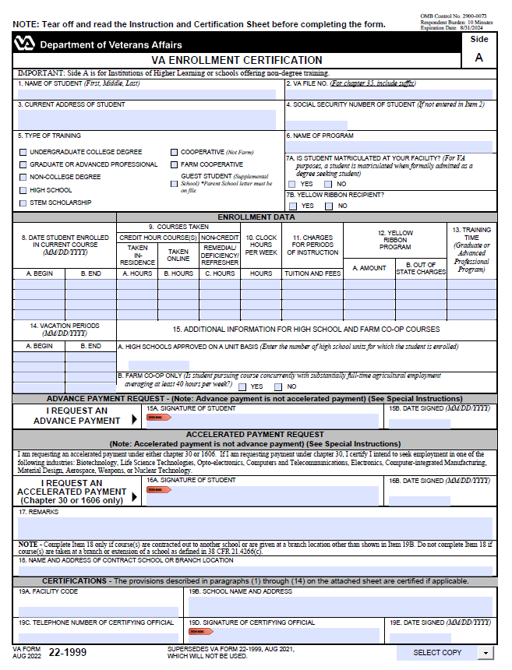
EM Overview – System Basics
Enrollment Manager (EM) is VA’s web-based system for certifying the enrollment and changes in enrollment of students. EM is the sole method of enrollment submission to VA. Access is accomplished through the Internet and is available to all schools approved for Veterans’ training. EM functions with any internet browser.
EM provides a better SCO experience and is more efficient than submitting enrollments via Paper Forms.
Notes:
Alyssa

Slide 5
EM Overview – Purpose
The purpose of this presentation is to provide information and tutorials on how to use EM, the system for entering enrollments, changes, and monthly certificates. Within EM, SCOs can do the following:
Create shared student records between VA and EM
Associate a student with a facility
View student information
Submit student certifications
Add notes to a student profile and their enrollment
Regarding exceptions, VA will continue to accept paper hard copy enrollments mailed or through Ask VA for the following programs or training types, which are not supported by Enrollment Manager:
Correspondence Training
Chapter 32
Restricted Foreign Schools locations
Facilities permitted to teach-out of existing students
Notes: All information contained in this presentation is based on fictitious names, Social Security numbers (SSN), and other personally identifiable information.
Return to Table of Contents

Slide 6
EM Terminology

Slide 7
EM Terminology (1 of 2)
Labels | Definition
Statuses
In progress | Enrollment/Amendment/Certification in in draft state.
Pending SCO Review | Draft entered by an Assistant or SCO Read Only must be verified and submitted by School Certifying Officials.
Processed | Enrollment/Amendment/Certification has been processed.
Submitted | Enrollment/Amendment/Certification was sent for processing.
Under Review | Enrollment/Amendment/Certification was off-ramped for manual review.
Terminology
School, Institution, Facility | Includes all institutions of higher learning as well as nontraditional courses/programs where education or training is pursued.
Assistant (SCO Assistant, Certifying Official Assistant, School Certifying Official Assistant) | Assistants have full access to a student’s profile such as the Enrollments, Student Info, Programs, Benefits, History, and Notes, and the Reports tabs. They can enter data in EM but cannot submit trainee enrollment information to VA. Assistants are not listed on the VA Form 22-8794 and do not complete any required SCO training. New Assistants are granted access to EM by their designated facility SCO.

Slide 8
EM Terminology (2 of 2)
Labels | Definition
Terminology
School Certifying Official Read Only (Read-only Users, Read Only SCO, Read Only Certifying Official) | SCO Read Onlys are representatives with permission to access training information, request information from VA, and submit inquiries to VA to assist an authorized designated SCO with obtaining accurate information to certify a student’s enrollment. SCO Read Onlys cannot certify a student’s enrollment to VA.
Student, Trainee | Individual using their GI Bill benefits to pursue educational programs, training, certifications, etc.
Program | Student’s chosen path of study that is pursued at a school. ​
Preset Enrollments | Term dates on approved school calendar that can be prepopulated
Online Credits | Web-based learning using one or more technologies to deliver instruction to students.
Amendment | Any change made to an enrollment after it is submitted.
Vacation Period | The dates of official school vacation periods which are 7 or more consecutive days. Used when certifying non-standard enrollment periods for all benefits.

Slide 9
Accessing EM

Slide 10
Logging in to EM
Accessing EM

Slide 11
Logging In
The first step to use EM requires the user to log in. Prior to being able to log in, there are several steps that must be completed. Once all steps are completed, users will be able to access EM.
Creating a(n) ID.me or Login.gov Account
SCO must create an ID.me or Login.gov account
Multifactor Authentication
SCO authenticates their identity by signing into the VA Education Platform through ID.me or Login.gov
Authentication
Requesting Access as an SCO
SCO requests access to EM through iam.education.va.gov
Receive Approval/Denial Email
VA verifies your information is accurate and all requirements have been met, then approves or denies access. SCOs receive an email upon approval/denial
Log into EM
Once access has been approved, SCO logs into EM through the VA Education Platform Portal and the blue “Open Enrollment Manager” button is enabled
email
password

Slide 12
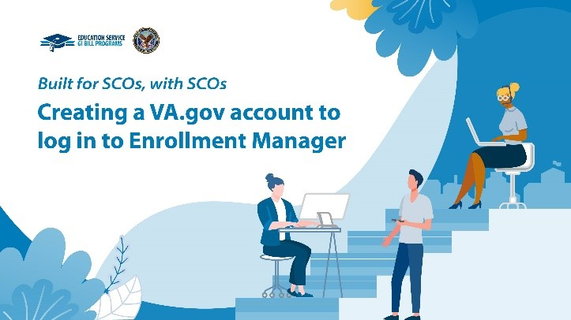
Creating an ID.me or Login.gov Account
EM makes supporting your GI Bill students easier than ever!
Before receiving access to student data and taking advantage of the enhanced VA experience, you need to create a VA.gov account using ID.me or Login.gov
VA strongly encourages you to complete this step as soon as possible to gain access to your EM account.
After verifying your identity, your ID.me or Login.gov account is ready to use for access to VA platforms!
Have questions? Let’s look at our Multi-factor Authentication Video!
Watch now!

Slide 13
The VA Education Platform & VA Education Platform Portal
The VA Education Platform is the login page to authenticate your identity through ID.me or Login.gov. The VA Education Platform grants you access to the VA Education Platform Portal through external, multi-factor authentication. The Portal is the system you must use to request access/log in to EM.
The VA Education Platform Portal is used for:
Non-VA employees to request access to Digital GI Bill applications
SCOs to sign into EM for the first time
Internal VA users manage SCO access to EM and assign schools to SCOs.
SCOs manage Read Only and Assistant Access to EM and assign school(s) to them
The VA Education Platform Portal went live on
Monday, March 6, 2023!
Navigate to iam.education.va.gov to get started!

Slide 14
How to Bookmark EM
We encourage you to manually bookmark: https://iam.education.va.gov
This is the VA Education Platform link!
Follow these steps:
Navigate to https://iam.education.va.gov .
At the top-right of the screen, click on the “Star”.
Next, select the “More…” button to edit the URL.
In the “URL” text field, input the exact URL https://iam.education.va.gov you want to associate with this bookmark.
Select the “Save” button to save the bookmark.

Slide 15
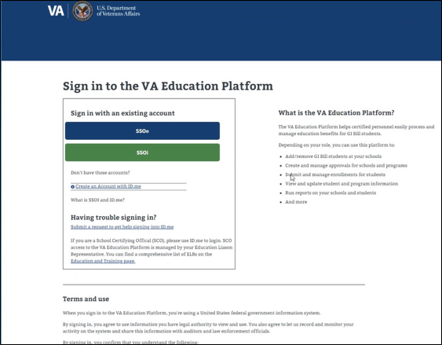
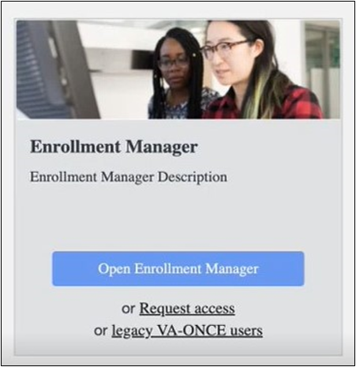
Log in through VA Education Platform Portal
With the launch of EM comes new processes for logging in, requesting access, and managing access requests. Below is an overview of these processes.
To log in to EM for the first time:
Navigate to iam.education.va.gov
As an SCO, Assistant, or SCO Read Only, you select the blue SSOe (Single Sign On External) button.
All users log in to the VA Education Platform using their ID.me or Login.gov account.
Once on the VA Education Platform Portal, new SCOs request access to EM by selecting the “Request access” button.
Users input their phone number, email address, role, state, and facility code to request access to EM.
Access Requests
Once you are approved or denied, an email will be sent to you.
Please do not submit multiple requests.
Notes:
ALL users will be brought to the VA Education Platform, seen in the image in the middle of the screen. The bottom option is for our existing VA-Once users, or legacy members. This was the information brought over from VA-Once, during the transition week. Little tip for you: if you haven't used VA-Once in awhile, you may want to use this pre-transition time to try logging in and make sure you don't need a password reset. VA-Once, as a system, does remove your access after an inactive time period. Making sure you are good to go now will save you some headaches when EM does go live.
Because the next option is to request access. This is for new SCOs, or those who have not previously used VA-Once; But can also be used for users who will not be officially submitting certifications- these could be work study students, advisors, or other individuals who have roles where access to view student submitted enrollments is deemed necessary. These are going to be the SCO- Read Only or Assistants, and will be approved by the school or institutions SCO.
If you receive a message denying access, please contact your Internal VA User.

Slide 16
Requesting Access as an SCO
Accessing EM

Slide 17
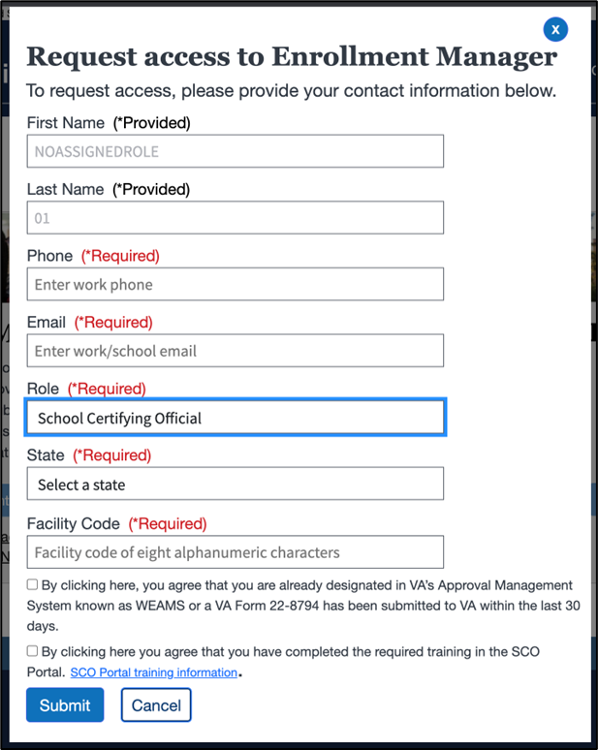
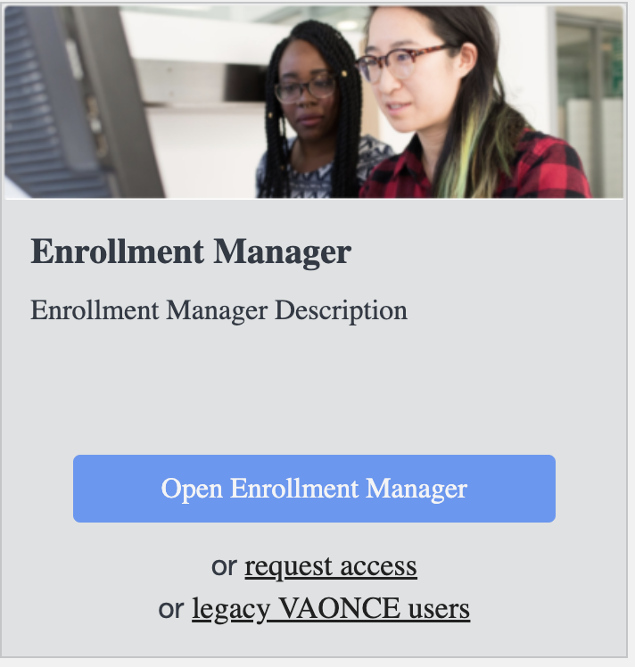
Submitting an EM Access Request
When logging in to EM for the first time, after authenticating identity through ID.me or Login.gov, SCOs, Assistants, or SCO Read Only need to request access from VA to access EM.
New SCOs Request First Time Access from VA
SCOs receive an email once access has been approved or denied

Slide 18
Managing Access for Assistants and SCO Read Only Users
Accessing EM

Slide 19
EM Key Functionality Demonstrations

Slide 20
EM Key Functionality
There are five key actions SCOs can take in the EM system. The functions are the same that SCOs performed on the VAF 22-1999 and VAF 22-1999b, with a new and improved User Interface.
FIND & ADD
A STUDENT
PRESET ENROLLMENTS
CREATE A STUDENT
ADD & SUBMIT
ENROLLMENT
AMEND/TERMINATE ENROLLMENT
In the student profile page of EM, SCOs search, find, create, and add students to their school’s database.
We have a demonstration that covers the student profile while also exploring the tabs for Enrollments, Programs, Benefits, History logs, and Notes tabs.
In the “Schools” tab of EM, SCOs can create preset enrollments to automatically add, pre-create enrollment periods to student enrollments.
Once created, preset enrollments are selectable when adding an enrollment for students and can save SCOs time.
In the student profile page of EM, SCOs can create students that are unable to be located through their school’s database.
Once created, enrollments can be added, amended, or terminated.
The Add Enrollment demonstration shows SCOs how to add new enrollment reporting dates, hours, and tuition and fee charges.
After inputting the enrollment information, SCOs can electronically submit the enrollment to VA.
The Amend an Enrollment demonstration shows SCOs how to submit changes to a student’s enrollment and quickly report the changes to the enrollment VA.

Slide 21
Find and Add a Student
EM Key Functionality Demonstrations

Slide 22
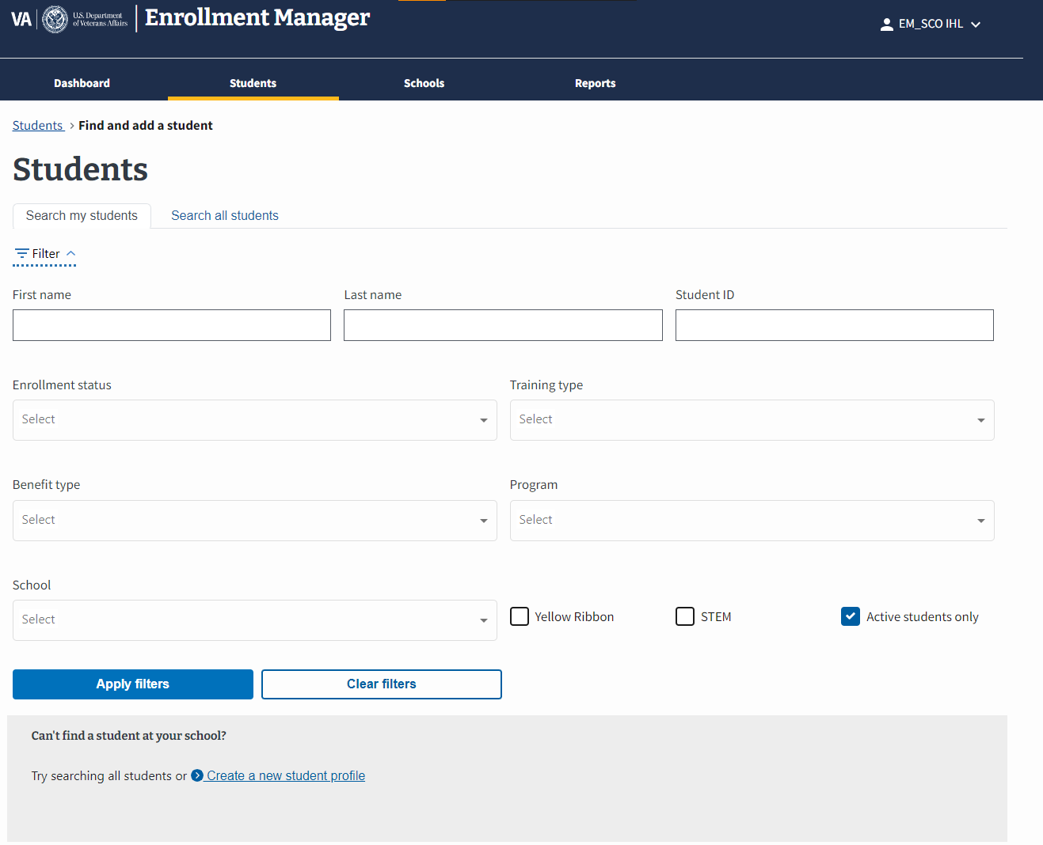
Find a Student
In EM, the user must first search for the appropriate student. You can search for a student by selecting the “Students” tab on the dashboard.
Select the “Students” tab on the dashboard.
Select “Search my students” or “Search all students” option to search for a student. Depending on the option selected, different field options populate.
The “Search my students” tab searches through all students associated with the school. You can search for a student by entering their “First name”, “Last name”, or “Student ID”.
The “Search all students” tab searches through all students in the VA database. You can search for a student by “First name”, “Middle name”, Last name”, “Email”, “Phone number”, or “Date of birth”
Note: Neither option allows a search by SSNs.

Slide 23
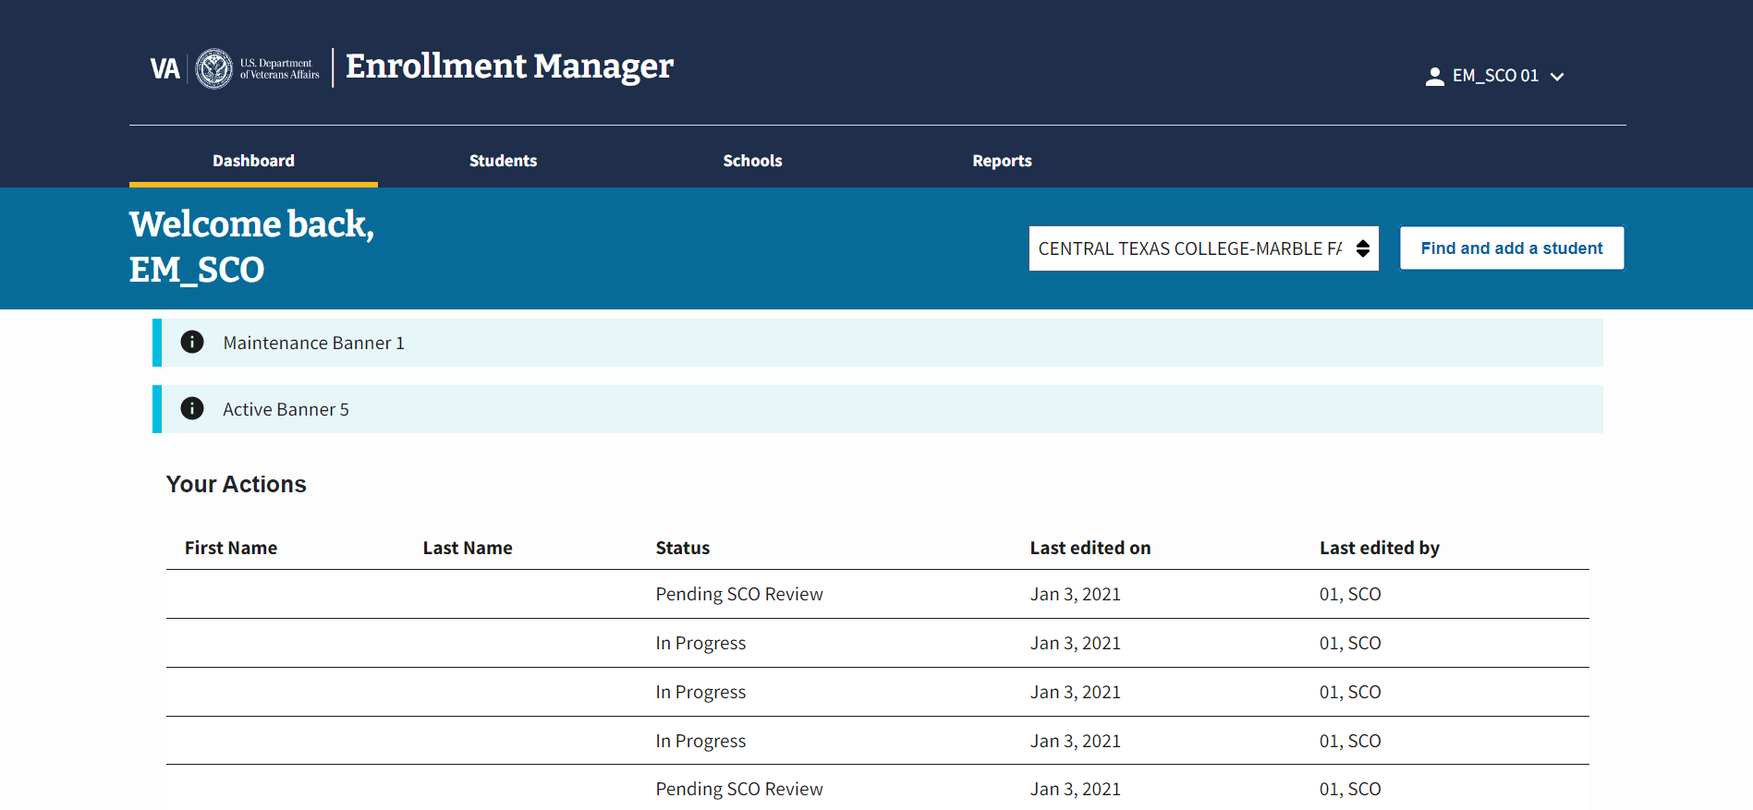
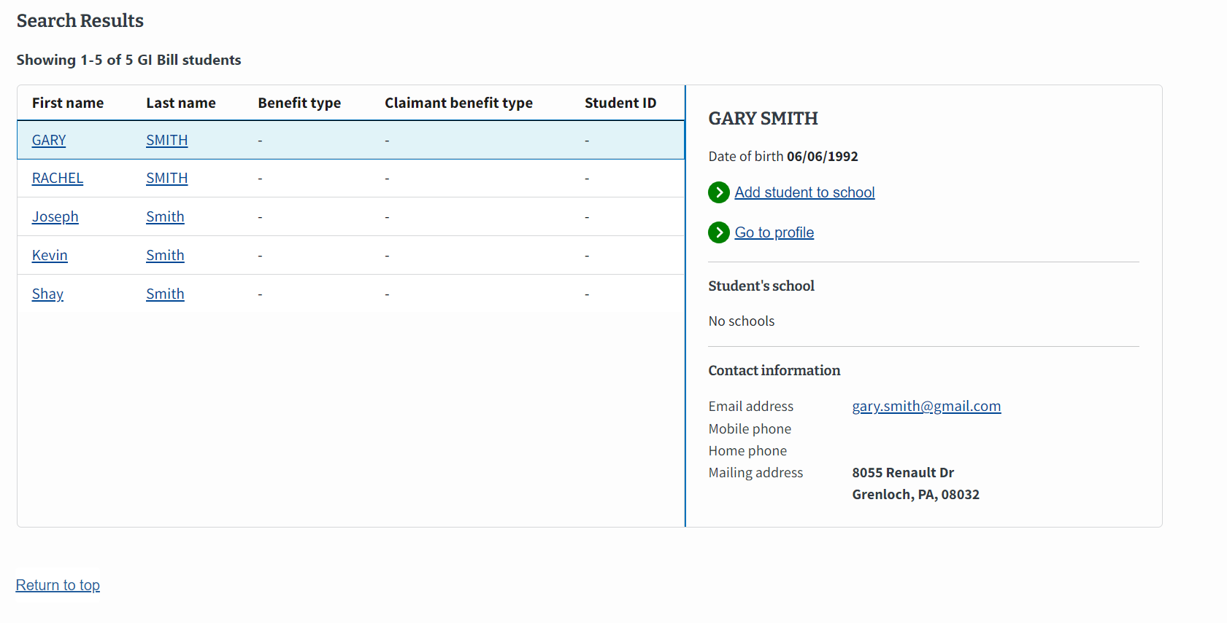
Add a Student
The next demo showcases the process a SCO takes when looking to find a student and add them to their respective school or institution.
This student, Gary Smith, currently exists in a VA system. Select “Add Student to school” button to associate them to your institution.
To add a student to their school, SCOs:
Select the relevant student from the list of results.
Select the “Add student to school” button.
The following screens in EM display the student’s known biographical, benefit type, and contact information.
Notes:
Presenter Notes: Stress that this is not just searching EM, but all of VA's data.

Slide 24
Preset Enrollments
EM Key Functionality Demonstrations

Slide 25
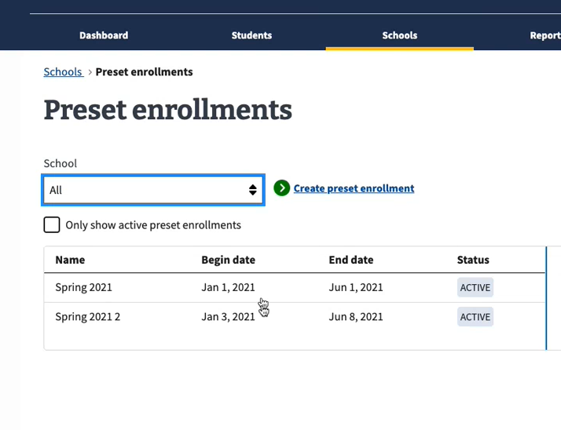
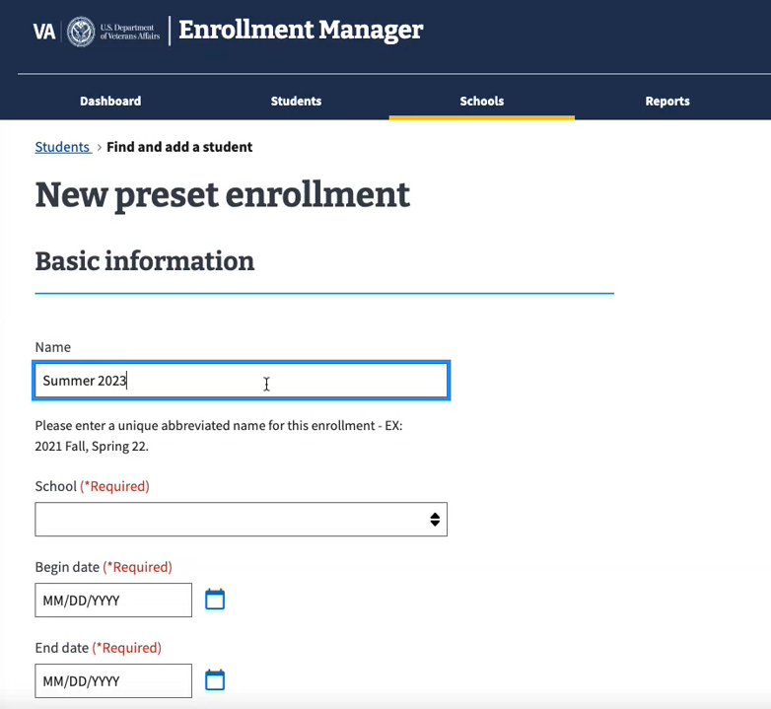
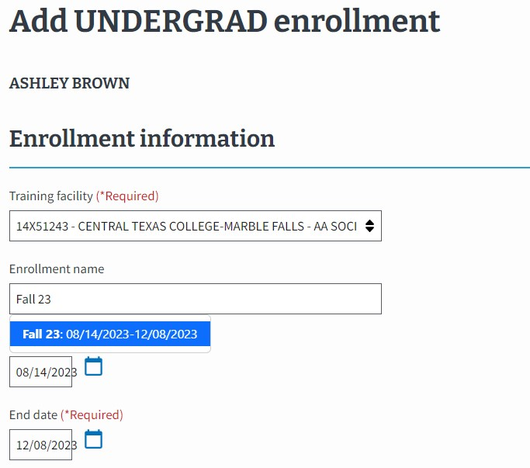
Preset Enrollments
SCOs can create Preset Enrollment term dates, which is helpful when there is more than one student being certified in an enrollment period. Once created, preset enrollments are selectable when adding an enrollment for students.
Step 1
Navigate to “Schools” tab and select the “Create preset enrollment” button
Step 2
Enter Preset Enrollment Information in the Basic Information section
Step 3
Choose Preset Enrollment in the “Enrollment name” field when adding a new enrollment

Slide 26
Create a Student
EM Key Functionality Demonstrations

Slide 27
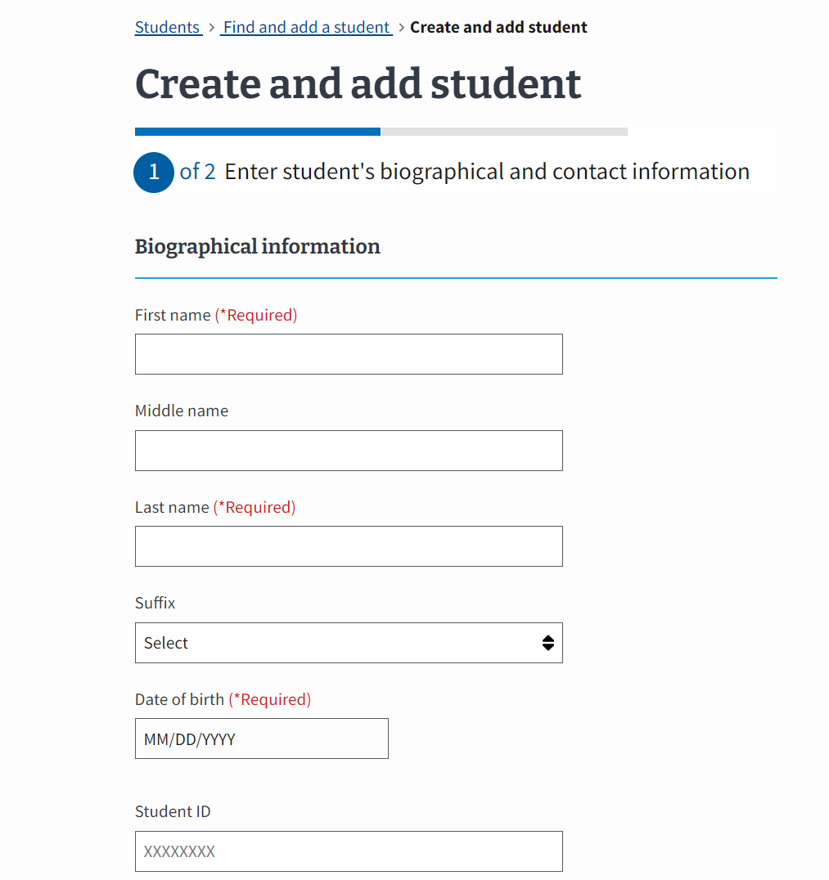
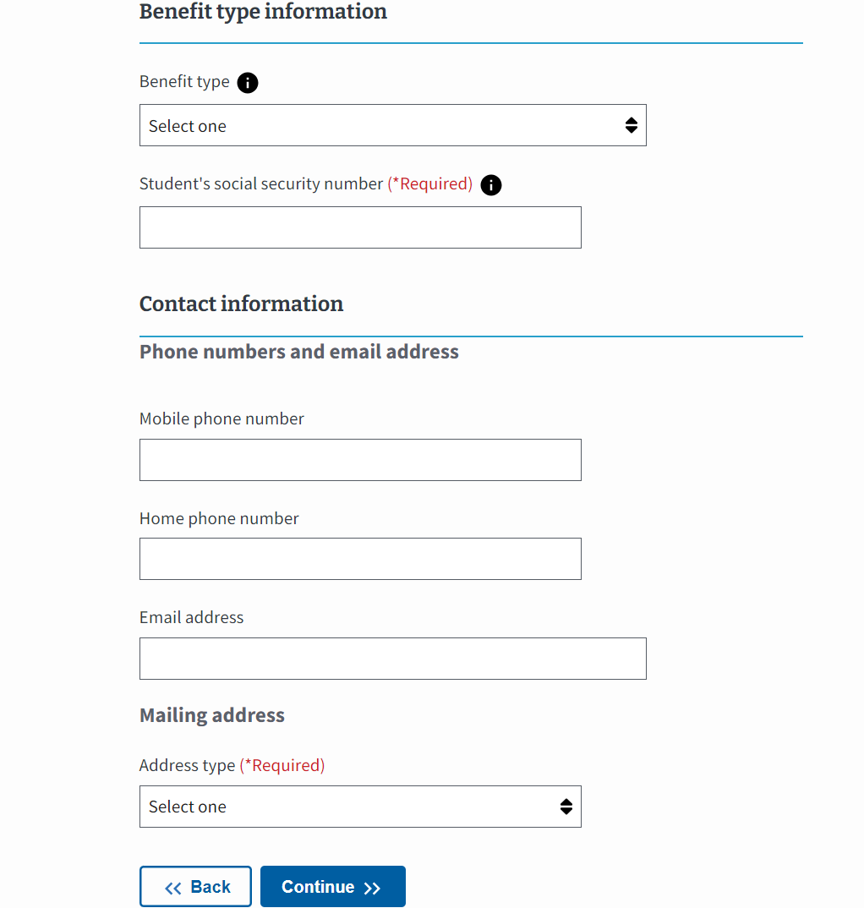
Create a Student (1 of 6)
Creating a student is not a common function for paper-based SCOs but it is still important to understand how to perform this action in Enrollment Manager. You begin by entering a student’s biographical, and contact information in EM.
In EM, there is a field to include the trainee’s “Benefit type”, which is mandatory to certify a student.
A
B
A
B
A

Slide 28
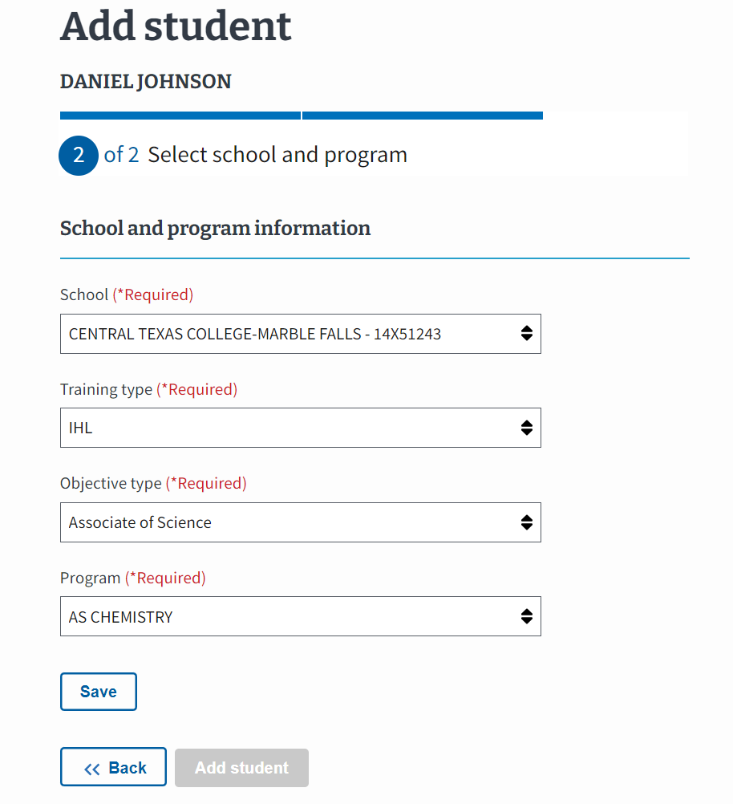
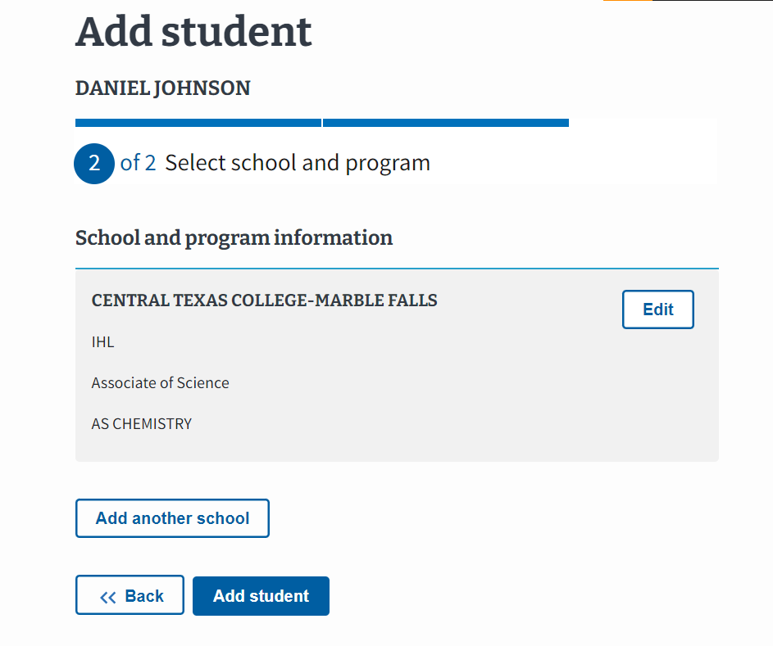
Create a Student (2 of 6)
SCOs only create a student if the student cannot be found through utilizing the “Search my students” or “Search for all” functions.
C
D
D
C

Slide 29
Create a Student (3 of 6)
In EM, the user must first navigate to the “Students” tab in order to create a new student profile. Follow the steps detailed below to create a student.
Select the “Students” tab on the dashboard.
Select the “Create a new student profile” link in the “Can’t find a student at your school?” gray box.

Slide 30
Create a Student (4 of 6)
Once a student's profile is created, changes to a student’s biographical or contact information must be initiated by directing the student to the Education Call Center (ECC) or Ask VA (AVA).
Enter the student’s Biographical, Benefit Type, and Contact Information and select the "Continue" button to proceed.
Note:
It is the responsibility of each student to update their address and any other biographical information. If the information is incorrect, students need to reach out to the Education Call Center (ECC) or AskVA (AVA).
SCOs can only add biographical information for new students who do NOT exist in the VA system.
Social Security numbers (SSNs) will only be used when creating a new student. They cannot be viewed, edited, or searched in EM.

Slide 31
Create a Student (5 of 6)
In EM, to certify an enrollment for a student, they must first be associated with a specific school or program.
Enter the student’s school and program information and select the “Save” button when complete.
Select the “Add Student” button to finish creating your student.
Note:
If a student is under the age of 18 years, a warning message displays.
Each dropdown arrow highlights the following information:
School – Contains all the facilities to which the SCO has access to.
Training type – Contains the unique training types available at the selected facility.
Objective type – Contains the various degree or certificates available at the selected facility. If the student is a guest student, select the “Guest Student” checkbox and the appropriate “Objective Type” from the drop-down. When selected, the “Program” defaults to “Guest Student” and the “Parent Facility” field is required and displayed.
Program – Contains a list of the programs listed in WEAMS which are available at the selected facility. In addition, non-matriculated and undeclared are available drop-down options that are enabled and displayed if the Training Type is IHL.

Slide 32
Create a Student (6 of 6)
To learn more about the other tabs on the student profile, please refer to the EM User Guide .
The student has been successfully added and the “Add enrollment” button is now selectable.
Note: Students must have a benefit type associated with their profile before an enrollment can be added.

Slide 33
Add an Enrollment: VAF 22-1999 Side A – EM
EM Key Functionality Demonstrations

Slide 34
IHL: VAF 22-1999 Side A vs EM Functionality
This section outlines how to submit an enrollment certification. Begin with the table below to identify the task as it is completed using VAF 22-1999 Side A and how the task is completed in EM. Each numbered task aligns with the numbered items in the pages that follow.
# | Task | VAF 22-1999 Side A | EM – IHL
1 | Student Information (Name and Address ) | SCOs wrote a student’s name and current address on the form. | Located at the top of the screen, EM automatically populates the student’s name after finding, adding, or creating an enrollment. The address can be found on the right-hand bottom side of the screen.
2 | Begin and End Date for Courses | SCOs wrote the begin and end date for the courses a student was taking. | SCOs can use the calendar icons to select the appropriate begin and end dates for student courses. SCOs can also utilize preset enrollment dates to automatically fill in the begin and end dates.
3 | Credit or Clock Hours | SCOs wrote the number of credit or clock hours for each type of course taken. | SCOs type the numerical values for the number of credit hours for each type of course.
4 | Tuition and Fees | SCOs wrote the tuition and fees when required. | SCOs type the tuition and fees in EM when required.
5 | Vacation Period | SCOs wrote the vacation period data. | SCOs select the “Vacation period” button and populate the necessary data. Preset vacation dates can be selected in EM.
6 | Notes | SCOs wrote remarks concerning a student. | SCOs can choose to add a VBA remark or custom remark if needed. Custom remarks slow down processing time. SCOs should use the “Notes” section to capture internal student and school specific comments. Notes are not sent to VA but can be seen by other SCOs who access the student’s records.
7 | SCO Certification | SCOs certified enrollment by signing and then submitting the completed form to VA. | SCOs select the “Submit enrollment” button to transmit the enrollment to VA or select the “Save as draft” button.
Return to Table of Contents

Slide 35
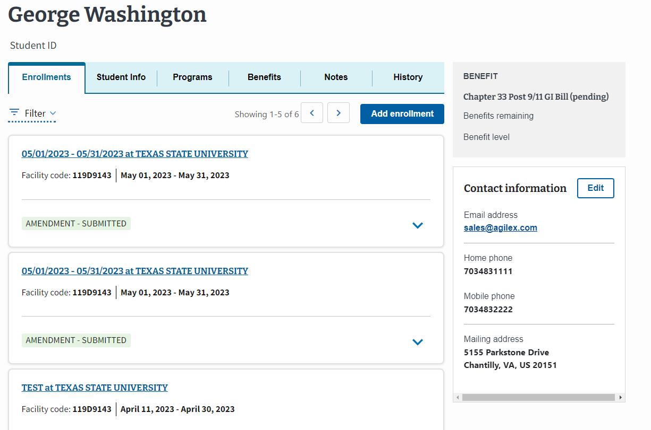
To create an enrollment in EM, select the “Add enrollment” button on a student’s profile in the Enrollments tab. Note: SCOs can add multiple enrollments at once by selecting the "Add multiple enrollment" option or add one enrollment by selecting "Add one enrollment" from the "Add enrollment" dropdown.
Add an Enrollment (1 of 5)

Slide 36
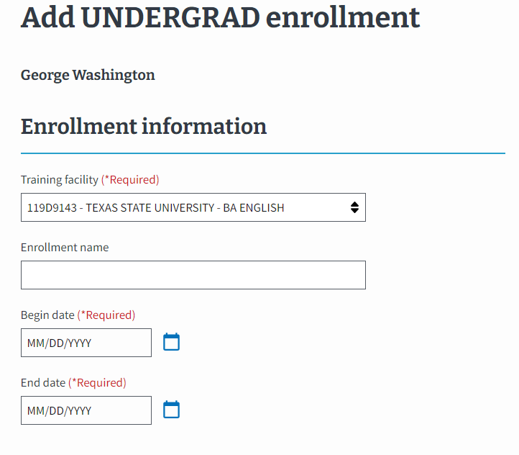
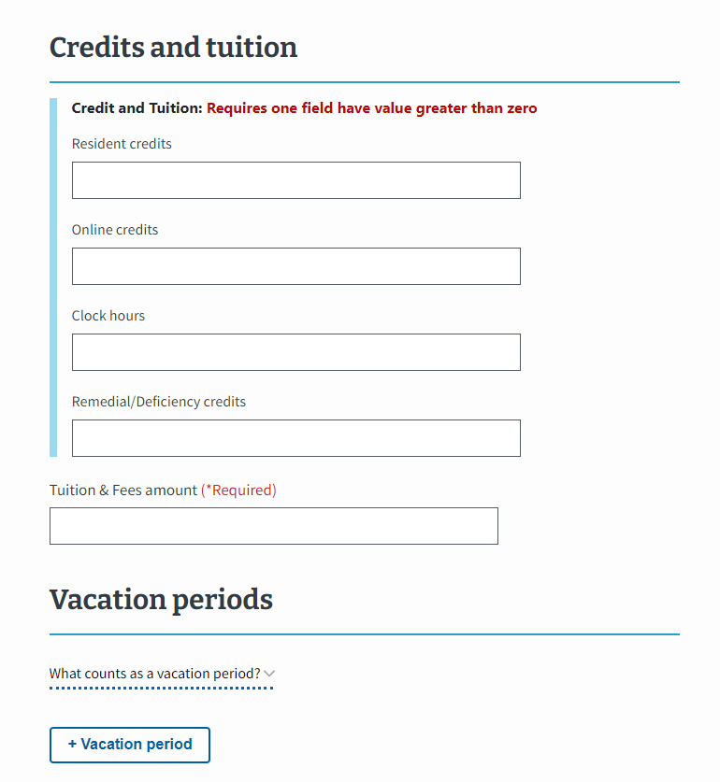
Add an Enrollment (2 of 5)
Enter the student’s relevant enrollment and credit and tuition information such as beginning and end dates, resident or online credits, and tuition and fees amounts.

Slide 37
Add an Enrollment (3 of 5)
If this is a non-standard length term with a published vacation period of 7 or more calendar days, it can be entered when submitting an enrollment. To make changes to the vacation period, select the “+ Vacation period” button. You can edit an inputted vacation period by selecting the “Edit” button.
Note: The Vacation period auto-populates from the Preset Enrollment if one was set up but please check to make sure the vacation period is correct and edit it or add any other breaks as necessary. You can hover over the text that says, “What Constitutes a Break?” for more information.

Slide 38
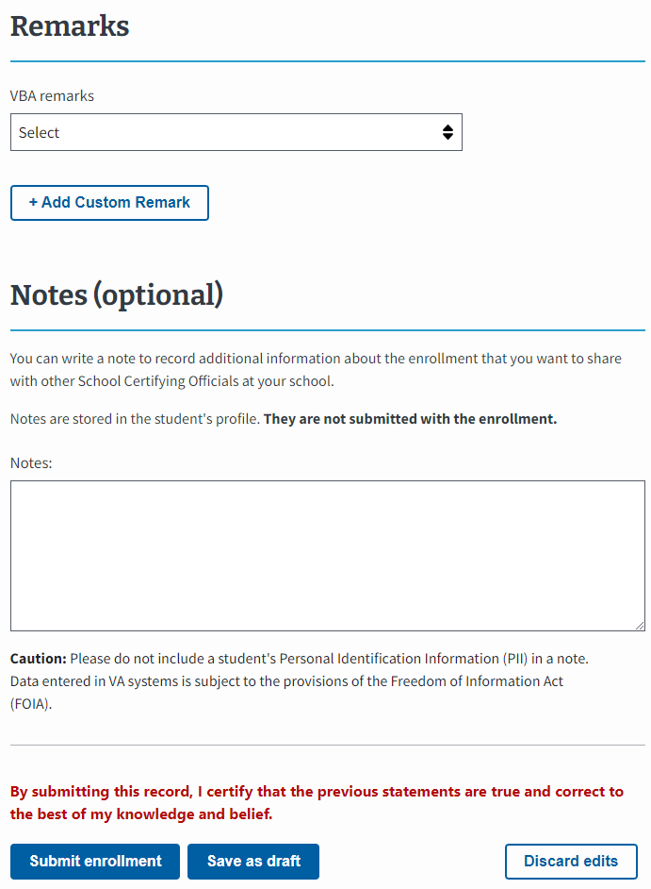
Add an Enrollment (4 of 5)
Before submitting the enrollment, add any notes for yourself or for other SCOs at your facility. Notes are not submitted to VA with the enrollment but can be reviewed by VA if necessary. Additionally, add any “VBA remarks” or “+ Add Custom Remarks”, as necessary as they can delay processing for your student certifications.

Slide 39
Add an Enrollment (5 of 5)
Rather than signing to certify the enrollment, in EM you will select the “Submit enrollment” button. Additionally, you can save the enrollment as a draft if you are not complete but do not want to lose your progress. Select the “Save as draft” button.

Slide 40
Amend and Terminate an Enrollment: VAF 1999b - EM
EM Key Functionality Demonstrations

Slide 41
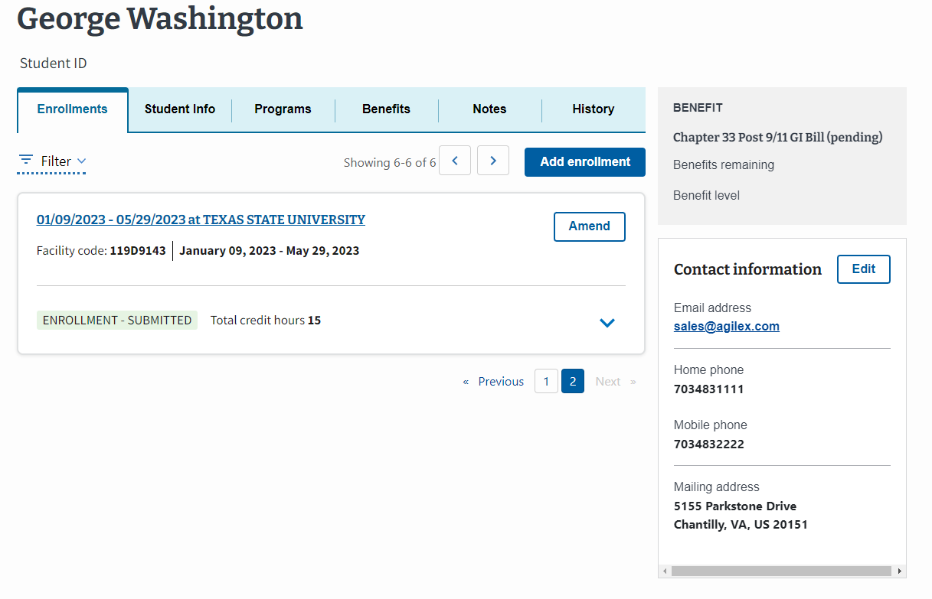
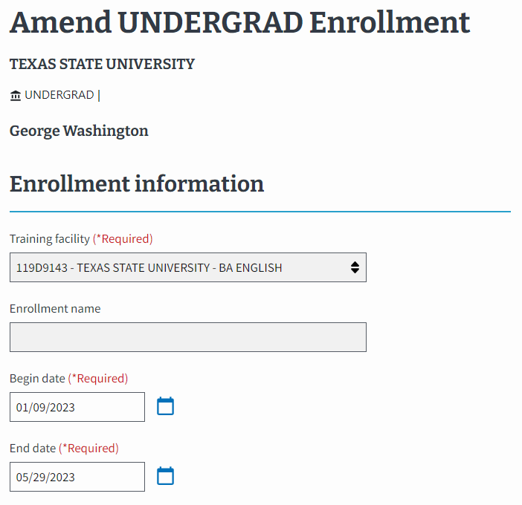
Amend and Terminate an Enrollment (1 of 3)
In EM, “Amendment” refers to any change made to an enrollment after it is submitted, including terminations. Select the “Amend” button to get started.

Slide 42
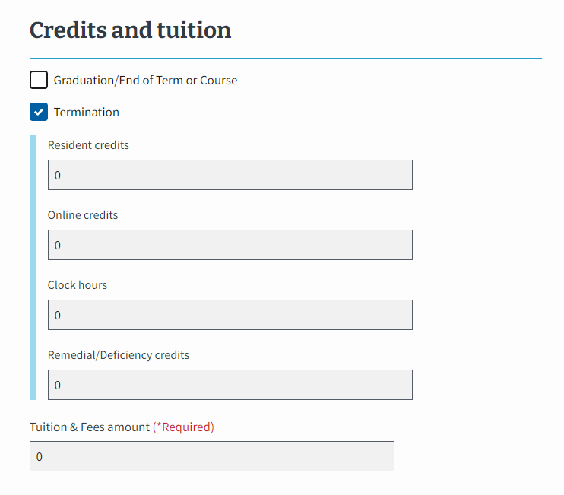
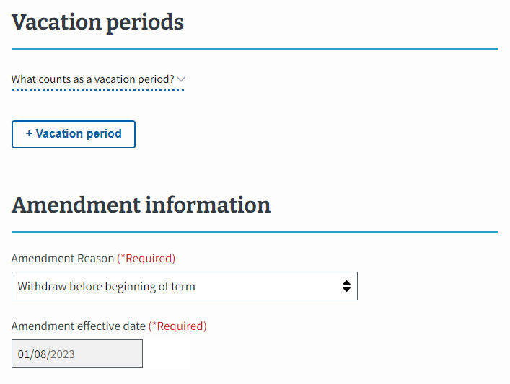
Amend and Terminate an Enrollment (2 of 3)
SCOs submitting a Termination or Graduation/End of Term or Course amendment for a student must check the respective box in EM. When amending, SCOs update the numerical values in the “Credits and tuition section” in EM.

Slide 43
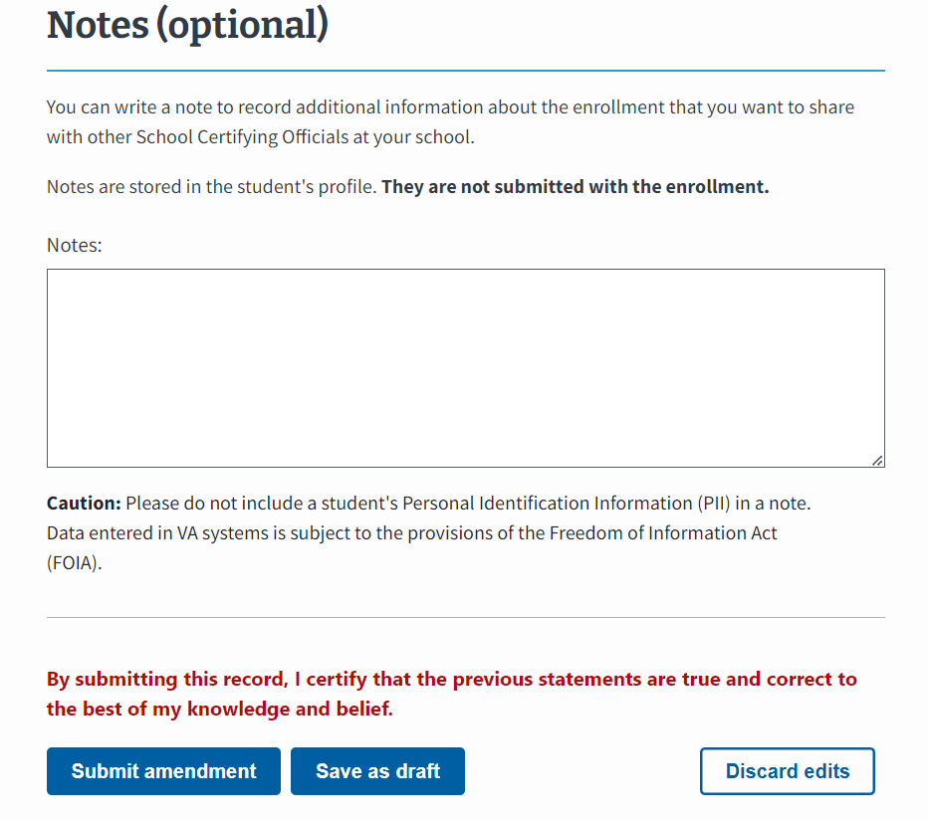
Amend and Terminate an Enrollment (3 of 3)
After inputting all required values for the enrollment and any optional notes, submit the amendment or save the amendment as a draft to return later to submit the enrollment.

Slide 44
Chatbot Billie
Notes:
Maitlyn

Slide 45
How to use EM Chatbot, Billie
The EM Chatbot, Billie is a self-service tool that is available for you to use 24/7, 365 days a year. Billie can help you navigate the new system and can provide answers to questions about enrollments you are working on. Check out the video on the next slide to learn more!
Billie is great at answering questions about:
Navigating EM
Submitting Enrollments & Certifications
Amending Enrollments
Entitlement & Debt
Legislative and Policy Changes
Tips:
We recommend exploring the pre-drafted questions Billie can answer first if you’re not sure where to start!
Click the “i” button in the bottom left corner to find all the topics the Chatbot can help you with
Billie is always there for you in the bottom right corner 24/7.
Enter “Hi” to return to the main menu
Reminder not to enter Personal Identifying Information (PII) into Billie

Slide 46
EM Communications
Notes:
Maitlyn

Slide 47
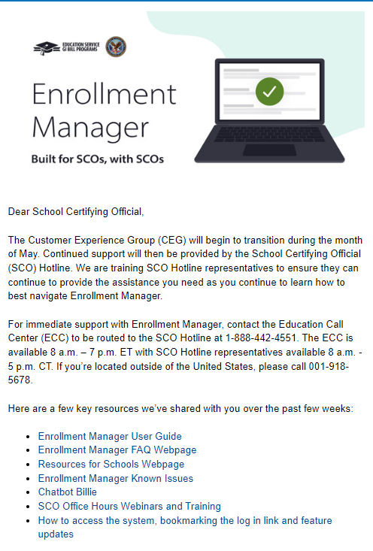
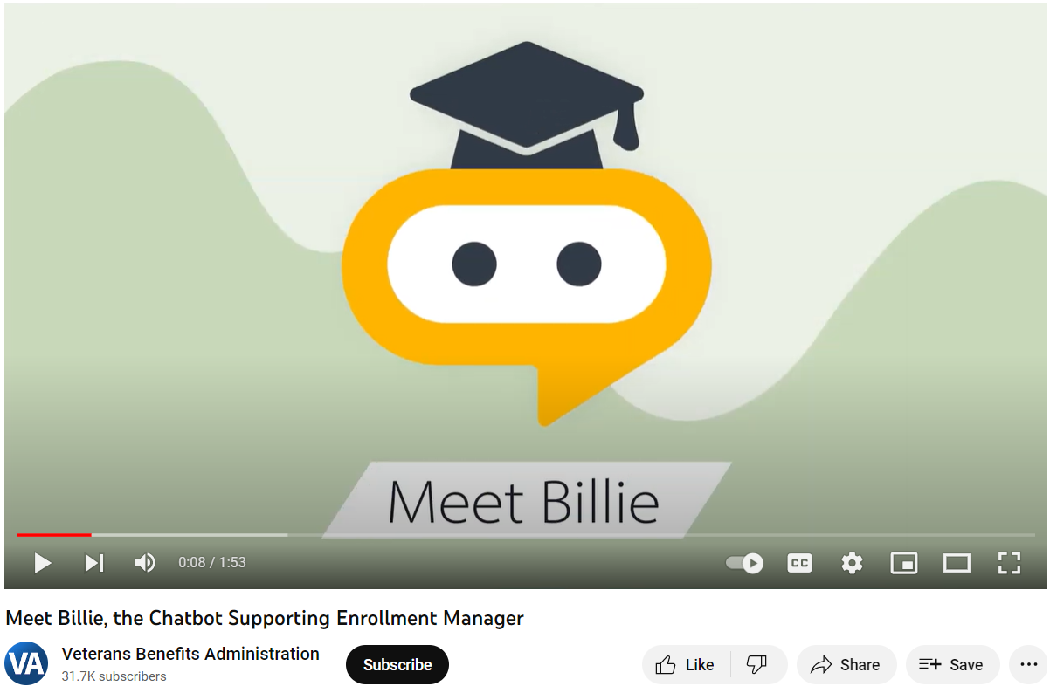
Communications about EM
As you get acclimated to EM, we are sending you communications about system updates, log in processes and resources. You can expect to receive communications through:
Emails & “SCO in the Know” Newsletter Updates
Videos
YouTube Channel: Veterans Benefits Administration
Social
Facebook:@GIBillEducation
We’ve got you covered!

Slide 48
Communications Overview
Below are the channels, content, and cadence we communicate EM updates.
Emails
Content: System updates, log in processes, Billie for support, tips and training resources.
Cadence: Updated 2-3 times a month
Web Updates
Content: Share the most updated resources on EM.
Cadence: Updated on a consistent basis, as needed.
EM Activity Banner
Content: Announce important information and updates.
Cadence: Updated on a consistent basis, as needed.
Newsletters
Content: Provide the latest updates via “SCO in the Know” newsletter articles.
Cadence: Bi-monthly
Social Posts
Content: Share posts about EM updates, events and feedback.
Cadence: Updated 1-2 times a month
Videos
Content: Share interactive, easy to follow, informative how-to videos for visual learners.
Cadence: Updating as major process changes occur, as needed

Slide 49
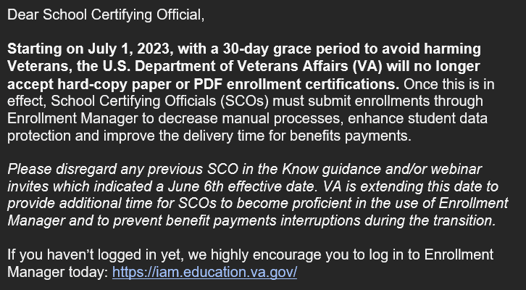
Overview
EM updates and important requirements for you to complete are shared in the SCO in the Know newsletter.
Upcoming Topics:
Resources to learn more about EM
Ask Billie
EM Best Practices
Tips for completing actions in EM
Subscribe to
“SCO in the Know”
for the latest updates!
1. Visit the Subscriber Preferences Page
2. Log in with your VA.gov email address and follow the prompts.
3. Update preferences and select EDU School Certifying Officials
4.Submit your list of updated preferences

Slide 50
Video and Social Posts
In addition to the EM video presented earlier, social posts are shared to provide exciting updates related to the new system.
Check out this post on Facebook to see where training products and resources for EM can be found.
Stay up to date on VBA social platforms!
@VAVetBenefits
@VABenefits
@GIBillEducation
Connect with us
Notes:
Survey Q- Do you like/watch videos? Would you like any more how-to videos on specific topics?

Slide 51
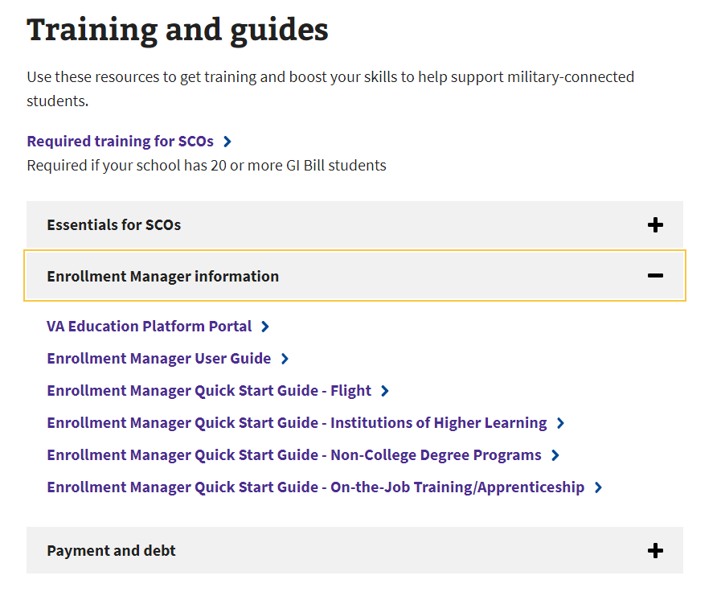
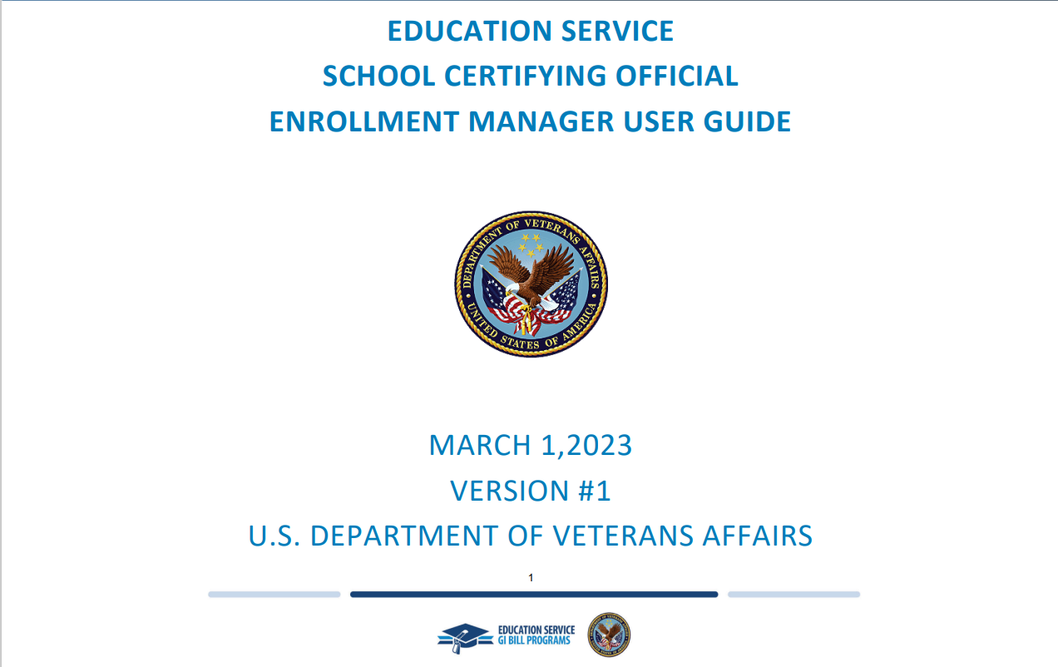
Web Updates
The Resources for Schools webpage has the most updated EM resources to help you navigate the new system. We highly encourage you to review the User Guide to get started.
Links to webpages
Education and Training homepage
https://www.benefits.va.gov/gibill/index.asp
Resource for Schools webpage
https://www.va.gov/school-administrators
EM User Guide
https://benefits.va.gov/gibill/docs/guides/enrollment-manager-sco-user-guide.pdf
Notes:
Survey Q- Do you like/watch videos? Would you like any more how-to videos on specific topics?

Slide 52
EM Resources

Slide 53
EM FAQ (1 of 3)
Are there going to be adjustments in Enrollment Manager or just amendments?
Is there an option to select Graduate/Undergraduate?
All changes made to an enrollment period after the initial Enrollment Certification is submitted will be called an “amendment,” including adjustments and terminations
Based on the Objective Type, SCOs can set up their students as Graduate or Undergraduate but cannot complete the action manually. When submitting an enrollment for a graduate student, the Training Time/ Full-Time Modifier field will be present for SCOs.
EM Frequently Asked Questions
Is there a preferred browser for EM?
Will SCOs have
access to student entitlement data?
Yes, you can access EM through Microsoft Edge or Google Chrome.
Yes, this information will be on the
Student Profile Page.

Slide 54
EM FAQ (2 of 3)
Will SCOs have to wait 24 hours between making amendments to a certification?
What type of reports can EM generate?
Who can view “Notes” added in EM?
No, but please wait 10 minutes after submitting a certification if you need to make amendments to the certification for Ch 33 students.
EM can generate a Weekly Summary Report and a Weekly Detail Report.
Notes added to EM are viewable to all SCOs with EM access.

Slide 55
EM FAQ (3 of 3)
Will Enrollment Manager Provide Student Statuses?
Can SCOs add Read-Only or Assistants to EM?
Student Statuses will not be available within the initial release of Enrollment Manager. Future enhancements will continue to be made to the system after its initial release.
Yes. SCOs can add accounts for “Assistant SCO” and/or “Read Only” access. SCOs will also approve work-study student access requests.
How do we update a student’s birth date in EM?
What is the “Save as draft” button?
If the file number or date of birth (DOB) is incorrect on a student profile, please encourage your student to contact the Education Call Center directly at 888-GIBILL-1 (888-442-4551) to update their profile information
The “Save as draft” button allows SCOs to enter a student’s certification information and then come back later to finish/submit.
See more on the EM Frequently Asked Questions page!

Slide 56
EM Quick Resources

Slide 57
EM Quick Tips
Since EM’s opening, we have tracked top questions from the ECC and Office Hours Sessions. Several quick tips based on those questions are provided here.
Paper-Based Mandate
Starting July 1, 2023, with a 30-day grace period to avoid harming Veterans, the VA will no longer accept hard-copy paper or PDF enrollment certifications.
Once in effect, School Certifying Officials (SCOs) must submit enrollments through Enrollment Manager to decrease manual processes, enhance student data protection and improve the delivery time for benefits payments.
If you have further questions,
The EM User Guide and Frequently asked questions (FAQ) are great resources for quick answers.
To search a specific issue, click "Control F" on your keyboard and type in what you are searching for. You can also access specific support by clicking on topics in the Table of Contents.
If you need extra
support logging in,
Make sure to complete the final step to verify your identity when creating your ID.me or Login.gov account.
Clearing your cache and cookies may also help!
Once you're in the system...
Please refrain from putting in duplicate user access requests.
Be aware of terminology updates; they’re listed on the EM FAQ Page for your convenience.
Reminder to begin tracking your student’s DOB to add a new student.
Save actions as you go!
Where is Remaining Entitlement?
The remaining entitlement for a student’s current benefit type displays in months and days on the Student’s Profile and Benefits tab.

Slide 58
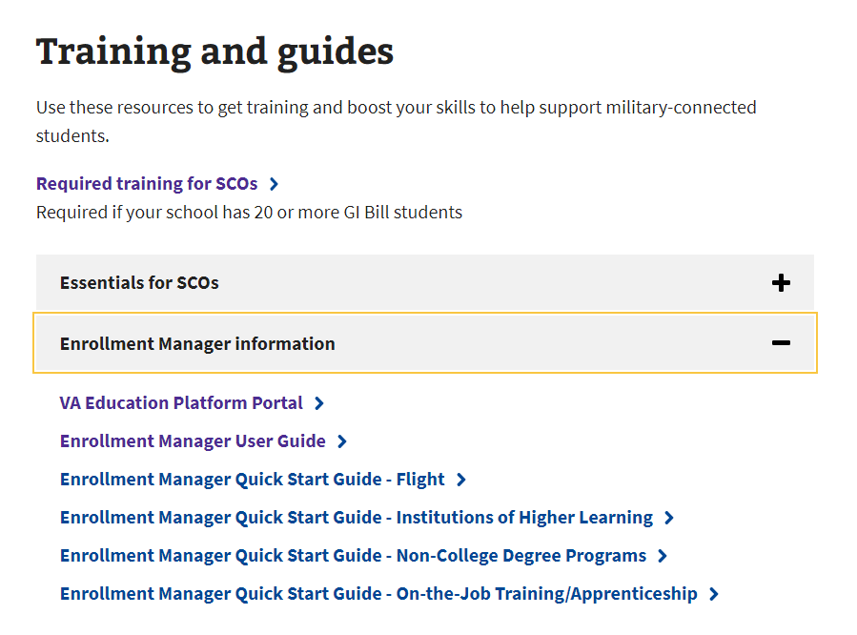
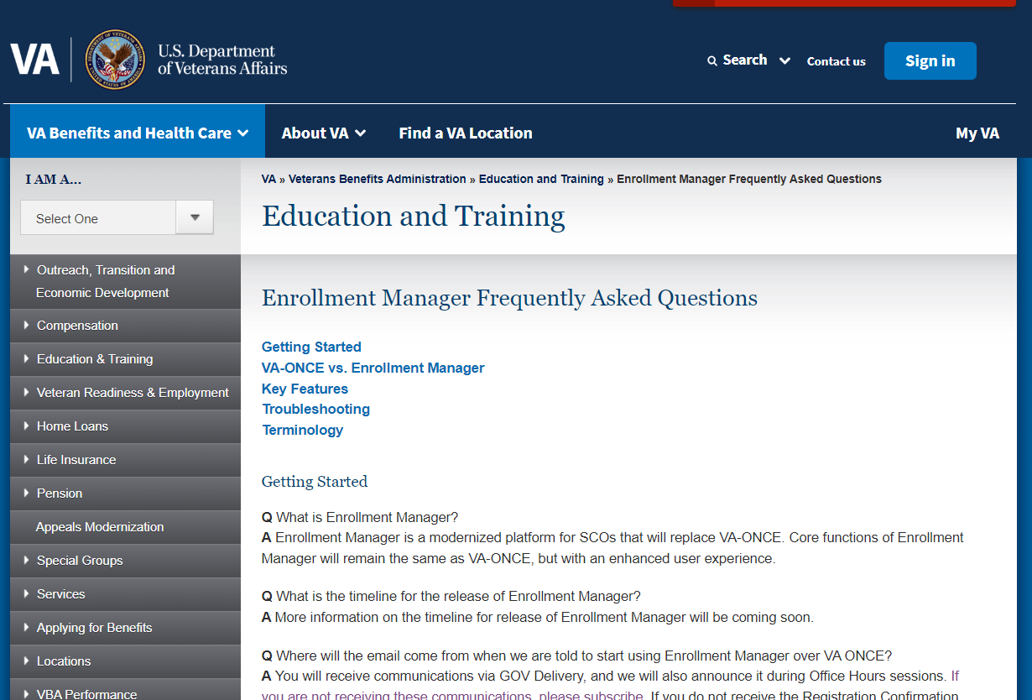
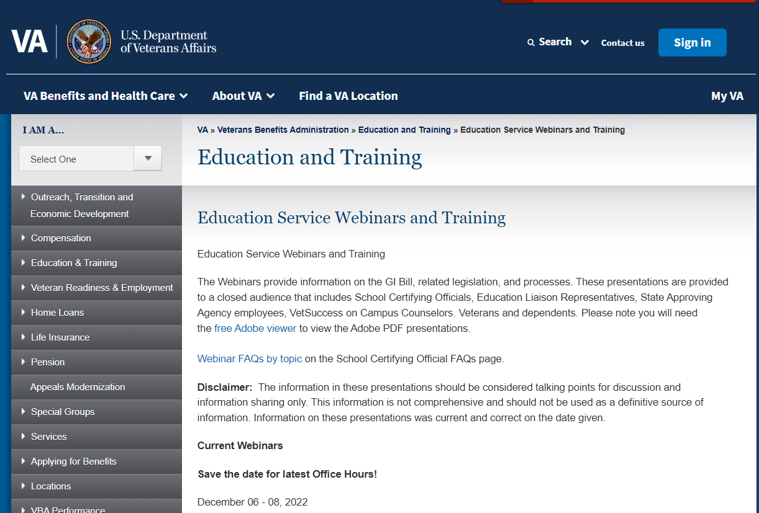
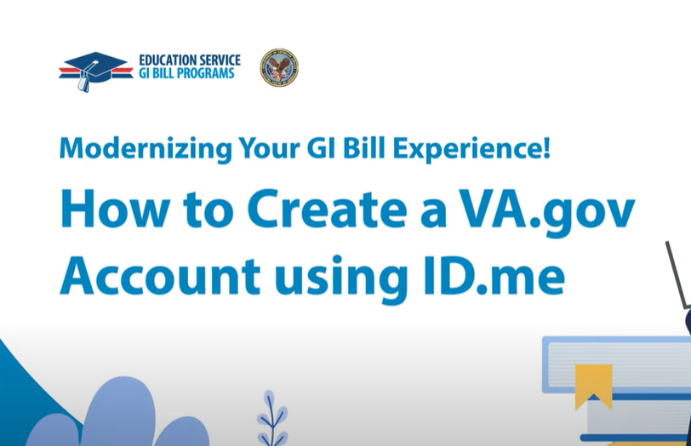
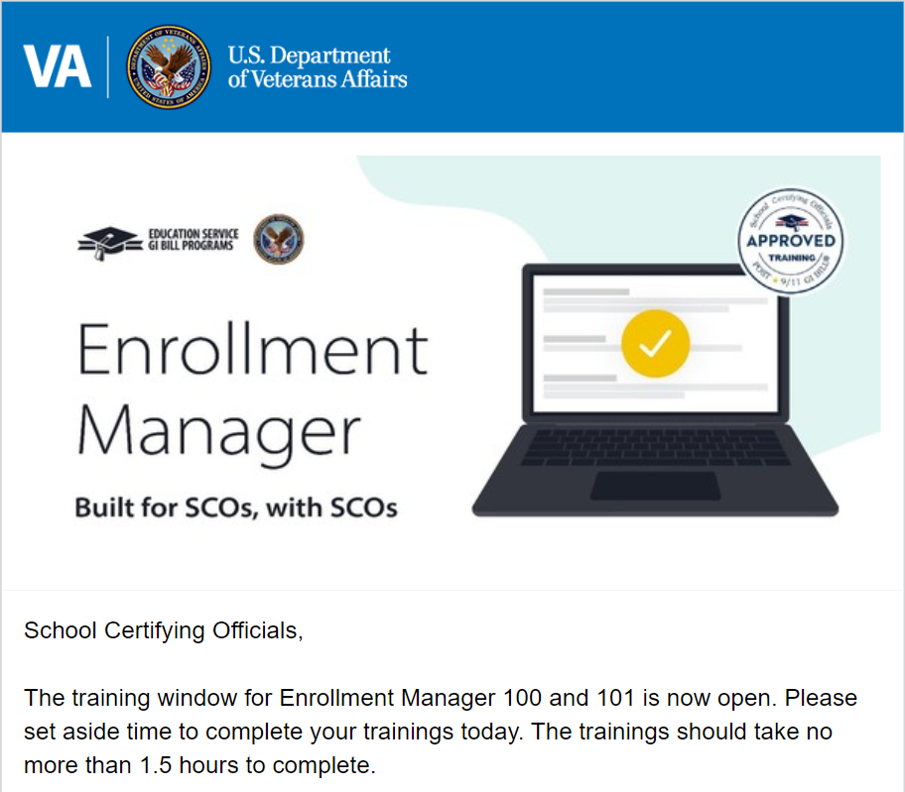
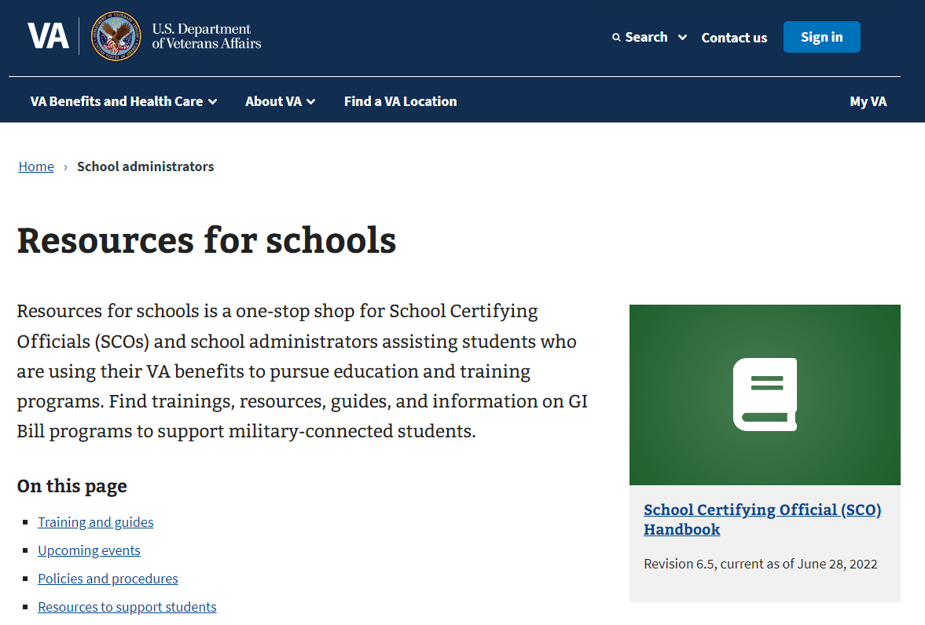
EM Resources Overview
The following materials can be referenced for further information.
00
SCO User Guide
SCO Training Portal
Quick Start Guides
EM FAQs
Videos & Social Posts
Office Hours
Emails
Web Updates
Visit the Resources for Schools page for more details
Notes:
To inform and prepare you for the upcoming EM improvements, the team is taking a comprehensive communications and training approach.
Emails:
Direct emails to targeted audiences about VA-ONCE Sunset, Readiness.
Newsletters:
Provide the latest updates via SCO in the Know newsletter articles.
Web Updates
Reflect the latest updates on EM and store key resources.
Office Hours
Present updates about EM, new resources, and trainings.
Videos
Provide interactive, easy to follow, informative how-to videos for visual learners.
Social Posts
Share posts about EM updates, events, and feedback.
VA-ONCE News Flash
Announce important dates and deadlines related to EM.
Workshops
Provide in-person and virtual opportunities to learn and engage with EM.
FAQs:
Searchable FAQs will house answers to important questions about EM.
Web

Slide 59
School Certifying Official Resources

Slide 60
Training and Self-Certification Steps
Step 6
Enter the Date of Training, then select the “Submit” button.
Step 4
Verify you have selected the correct training session, then select the “Continue” button.
Step 2
Select one:
”Office Hours”
“Conference Sessions”
“Supplemental Training”
Step 5
Select the “Yes” button to certify you have completed 100% of the training. Select the “Submit” button.
Step 7
Download your results and keep the certificate for your records. page.
Step 3
Locate the applicable session and select the “Begin” button.
Step 1
Log in to the SCO Annual Training Portal.
Live Assessments

Slide 61
Certifying Official Contacts
ROLES AND RESPONSIBILITIES
Contact the ELR for:
Contact your SAA for:
Questions about reporting enrollments and related changes​
85/15 reporting matters
Clarification of WEAMS 1998 reports
Contact Information
Education Liaison Representatives
Program revisions: new/suspended/cancelled programs
Updated catalogs and related publications
School address updates – including branches/extensions
Change in accreditation status
Change of ownership and change of address
Contact Information
NASAA State Contacts
Contact the SCO Hotline for:
Status of tuition and fee or Yellow Ribbon payments
Explanation of school debt creation
Individual student benefit information and hardship cases
Contact Information
Contact the Education Call Center at 888-GIBILL-1 (888-442-4551) and ask to be transferred to the SCO Hotline

Slide 62
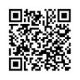
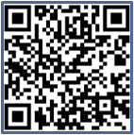
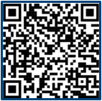
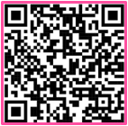
Additional Resources
Stay up to date on VBA’s
social platforms
Watch videos​ on VBA’s
YouTube channel
Scan QR Code to sign up for “SCO in the Know” emails​
@VAVetBenefits
@VAVetBenefits
@GIBillEducation
@VABenefits

Slide 63
July Office Hours
July 25th = Edu Staff & State Approving Agencies
July 26th = SCOs (Same Two Sessions) 11:00am & 1:00pm
July 27th = SCOs (Same Two Sessions) 11:00am & 1:00pm
~ Eastern Time ~
Your Personal Email Calendars Must Calculate Any Time Zone Differences
You must be registered in GovDelivery to receive all Office Hours Announcements!

